Slide 1
Studios Interop
For ATD Advanced Routing Environment
Brian Hayes

Slide 2
Overview
These slides contain examples and instructions of how to build end to end topologies with services in Cloud Vision Studios. Featured is the Enterprise Routing Studio that is used to inter-connect Campus and DCs together.
Arista Avanced Routing ATDs are used for these examples because they supply an easy environment for getting familiar with the interop between Studios that is required to configure complete networks.
Topologies Covered
Studios Used
Enterprise Routing
EVPN Services
L3LS
Campus
Interface Configuration
DCI
Campus Interconnect
ISP Connections
EVPN for Enterprise

Slide 3
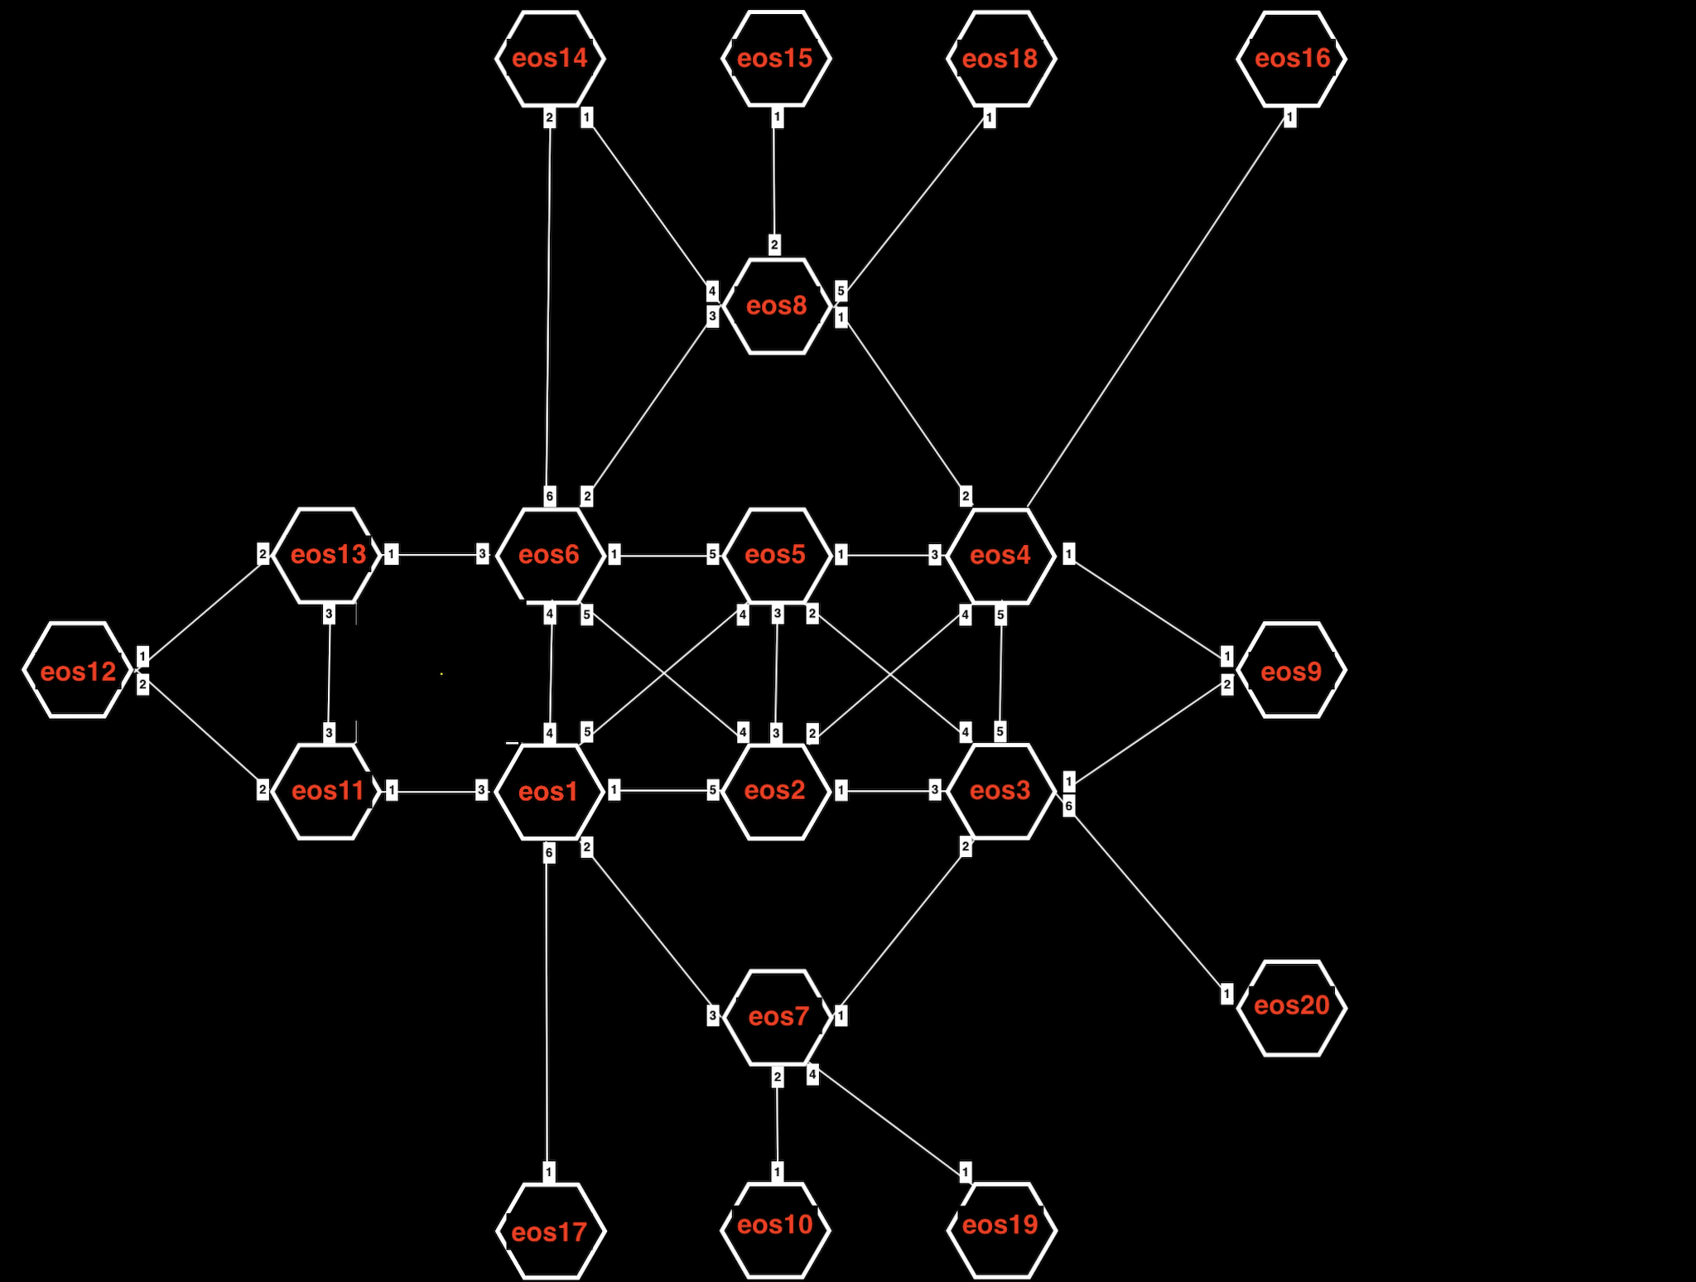
Complete Topology of the ATD
These examples use a sub-set of this topology for each Interconnect example

Slide 4
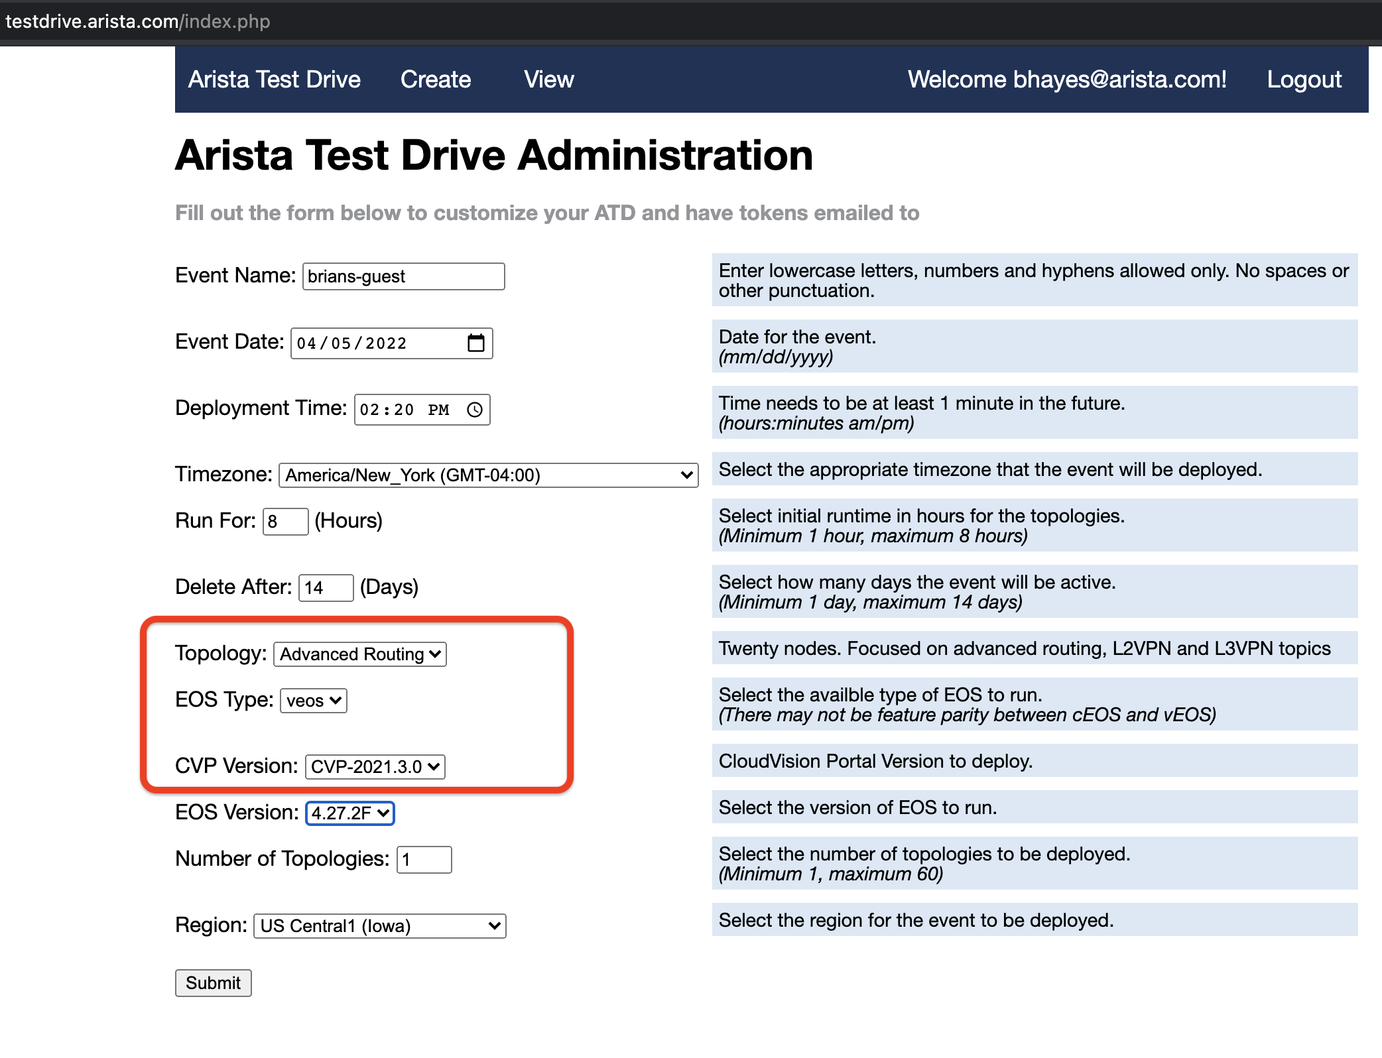
Launch the Advanced Routing ATD
https://testdrive.arista.com/ and launch the latest version of CloudVision

Slide 5
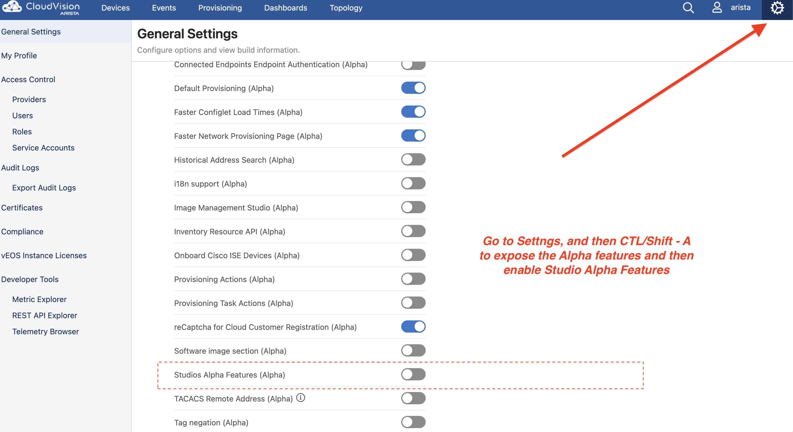
To import and export Studios Inputs files This is an Alpha feature and needs to be enabled in CV settings. This allows the example files that go with these slides to be uploaded.

Slide 6
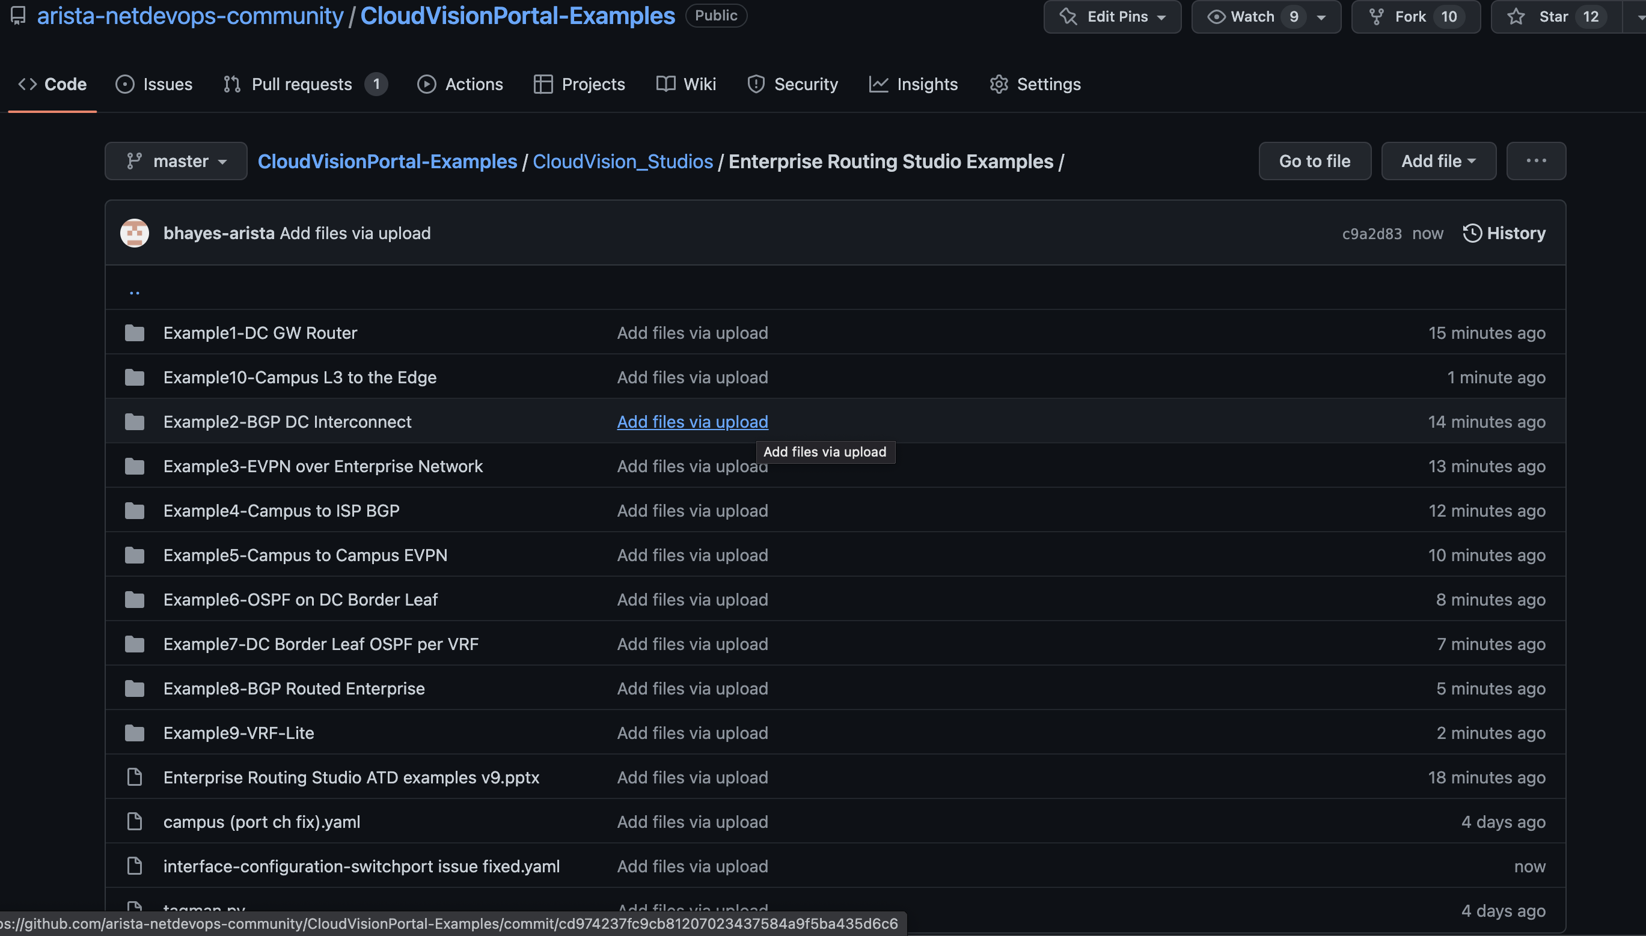
CV Studios GitHub site Clone these files to your laptop – details on next slide

Slide 7
Inputs Files
Input data and tags have been put into files to upload into CV
Files found here:
https://github.com/arista-netdevops-community/CloudVisionPortal-Examples/tree/master/CloudVision_Studios/Enterprise%20Routing%20Studio%20Examples
Clone the repository here:
https://github.com/arista-netdevops-community/CloudVisionPortal-Examples
git clone https://github.com/arista-netdevops-community/CloudVisionPortal-Examples.git
Enterprise Routing Studio is also found in this repository and must be loaded to the ATD until it is a built-in in the CV version in the ATD (Kent)

Slide 8
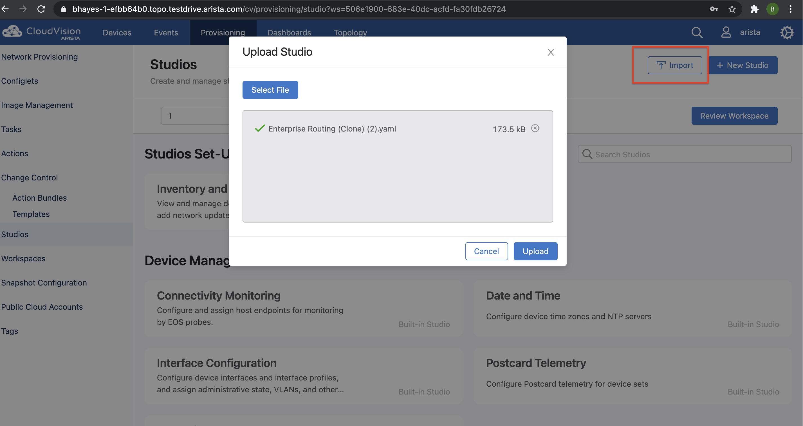
Import Enterprise Routing Studio into ATD
Once Kent version of CV is released this step is not needed because the Enterprise Routing will be a "Built-In Studio".
File location:
https://github.com/arista-netdevops-community/CloudVisionPortal-Examples/tree/master/CloudVision_Studios/Enterprise%20Routing

Slide 9
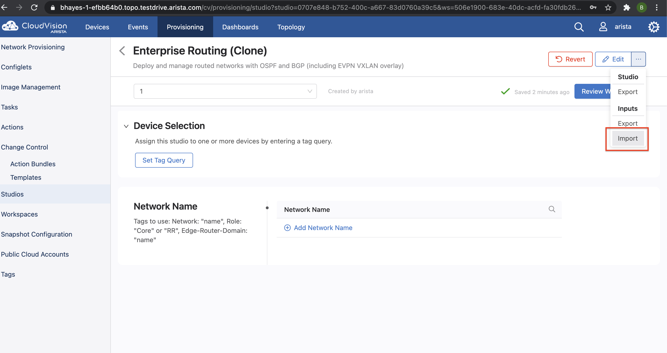
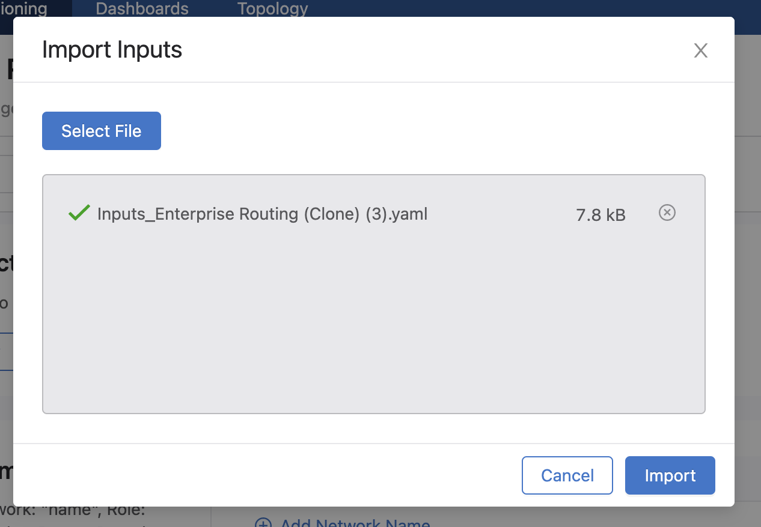
Import to CV the Inputs for each example
All Files found here:
https://github.com/arista-netdevops-community/CloudVisionPortal-Examples/tree/master/CloudVision_Studios/Enterprise%20Routing%20Studio%20Examples
Note: The interface configuration built-in studio has a bug, please use the fixed version found in the above repository

Slide 10
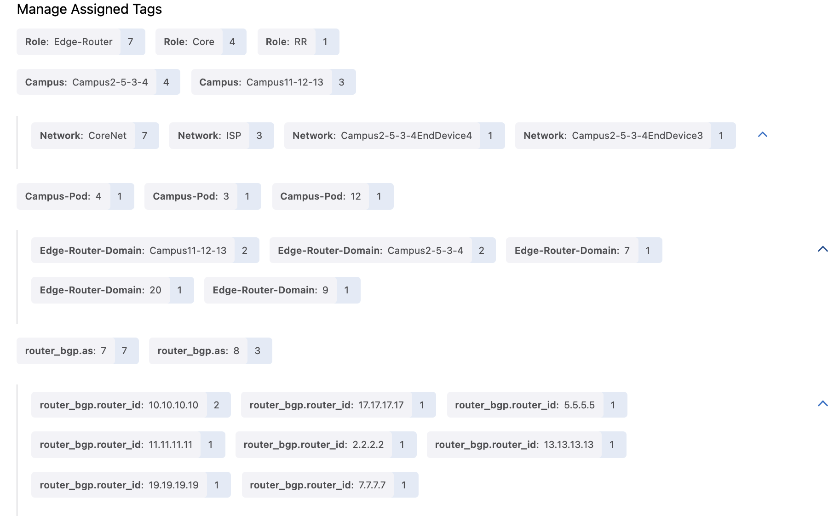
Note: Some Tags are created automatically by Studios and do not need to be entered
L3LS Studio and Enterprise Routing Studio will set ASN tags. The user does not need to create them.
L3LS Studio will set these lo0/router ID Tags. The user must create them in the Enterprise Routing Studio if using ISIS or EVPN.

Slide 11
Other Notes
Be sure to accept "updates" in the Inventory and Topology Studio prior to Selecting devices in each Studio
Be sure to check that the drop down yes/no fields in EVPN Services and Interface Studio are populated by the inputs files – Jackson release had a problem with this
When changing between examples be sure to clear the arp cache in the end devices prior to sending a ping – the mac of the gw may have changed
Use the version of Interface Studio on the github site – it fixes a bug where when changing from a routed port to bridged port is missing the "switchport" command
Use the version of the EVPN Services Studio in the github site – it has the added capability of redistributing OSPF into VRFs it creates
Both the router_bgp.as Tag and the router_bgp.router_id Tag (for lo0) are written by the L3LS Studio and do not have to be entered by the user but if Enterprise Routing Studio has EVPN/VXLAN enabled the router_bgp.router_id (lo0) tag must be added. These tags are in the tagsfile.txt
Using multiple role tags is only available in CV version Kent and beyond. If using Jackson do not use the Role: Edge-Router tag if L3LS is also using Role tags.

Slide 12
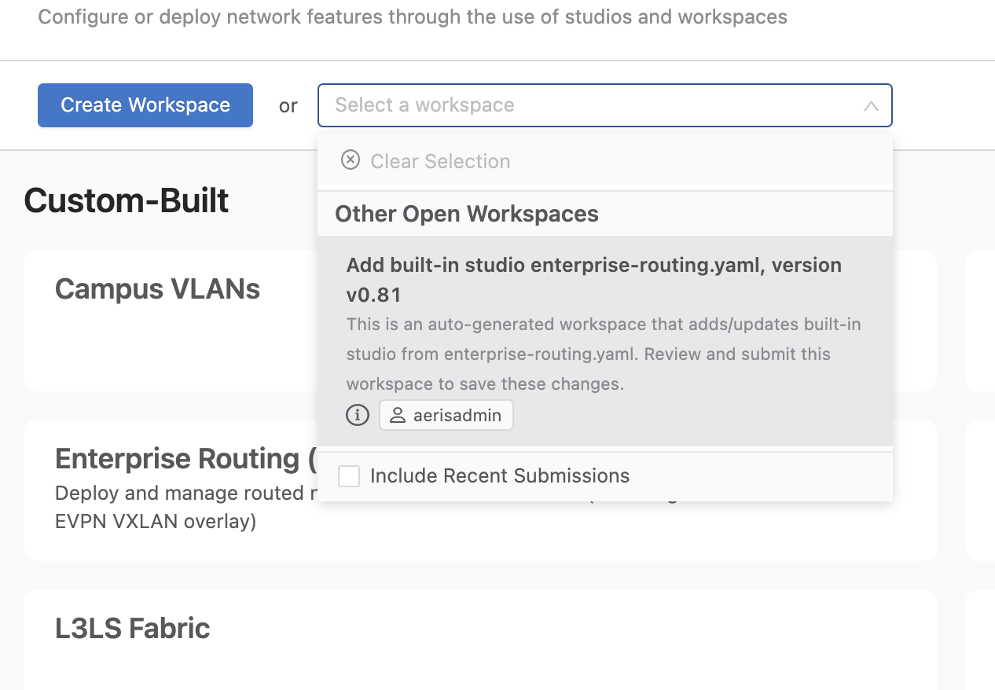
If doing an upgrade of CV, new Studios are in a workspace when the upgrade completes Submit this workspace! To add any new Studios permanently

Slide 13
Uploading Tags files with tagman.py
Tagman.py is a script written by Engineering to make saving and creating tag more easy. The tags are exported as a txt file and can then be re-imported or deleted.
See next slide for setting up your laptop to run tagman.py
The tagsfile defaults to using hostname but there is also an option for using serial number.
Use the –help option for the required syntax.
Example:
python tagman.py -u arista -p aristaf613 -c unf-arista-campus-vlab-1-11f86e35.topo.testdrive.arista.com -f tagsfile.txt -a export

Slide 14
Tagman.py setup
1. curl -O https://bootstrap.pypa.io/pip/2.7/get-pip.py 2. chmod +x get-pip.py
3. python get-pip.py
4. python -m pip install requests

Slide 15
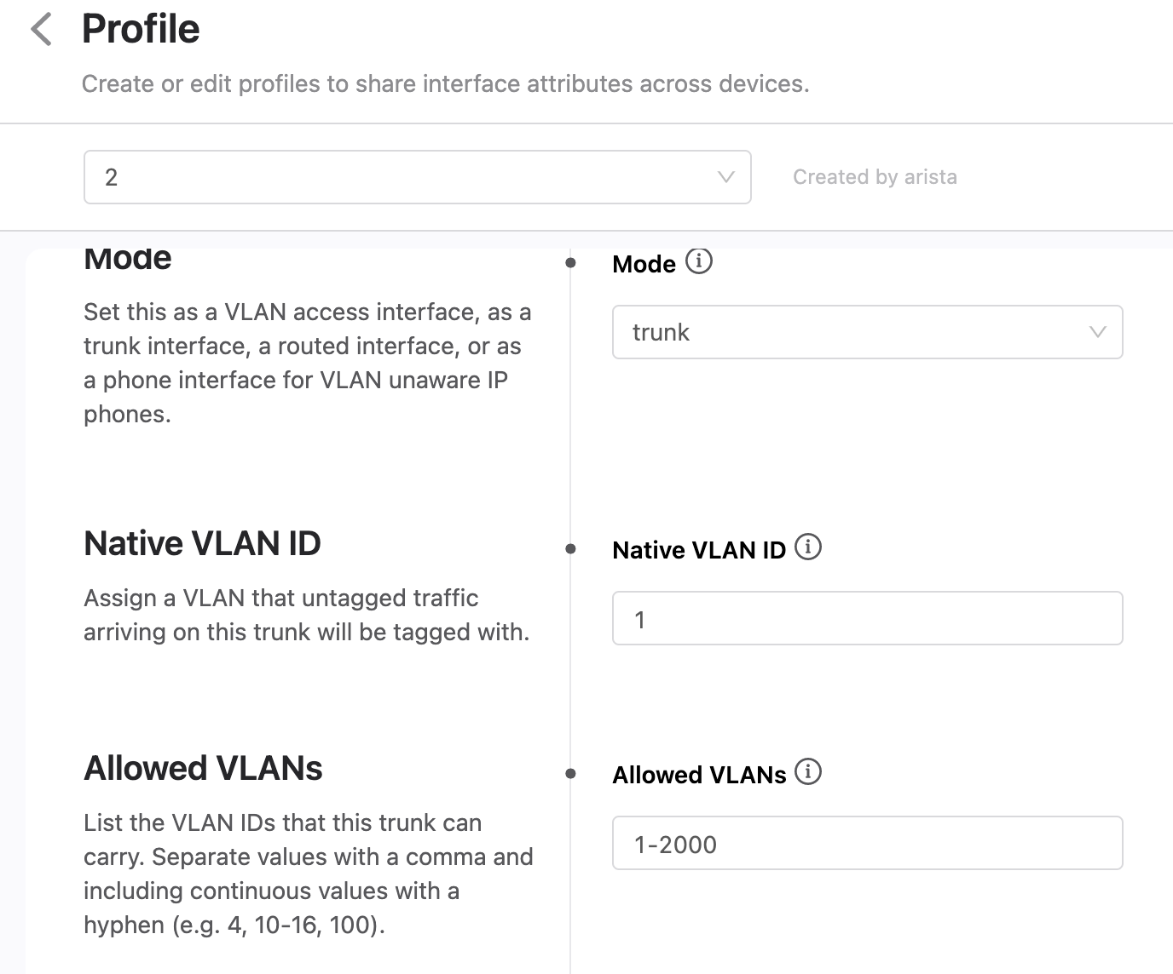
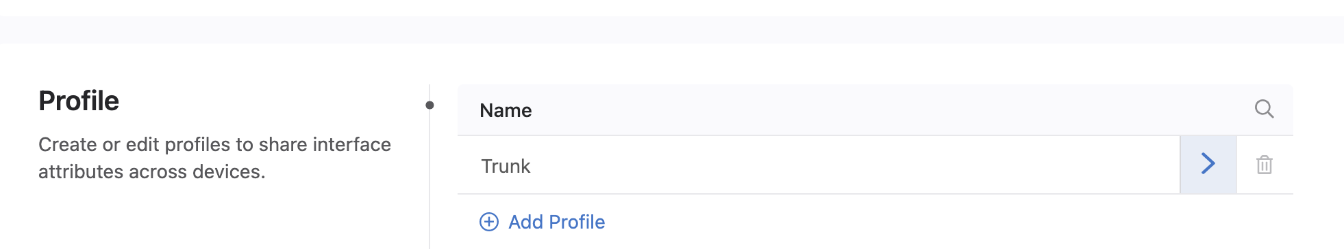
Interface Configuration Studio setup
Create a profile called Trunk in the Interface Configuration Studio. It will be reused throughout the examples.

Slide 16
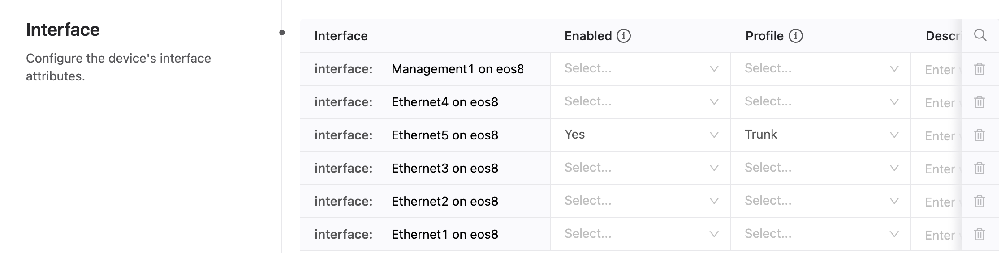
Interface Configuration Studio setup
End devices plugged into edge switches use vlan tagging so the edge ports are configured as trunks. The ports requiring this profile are given for each example.

Slide 17
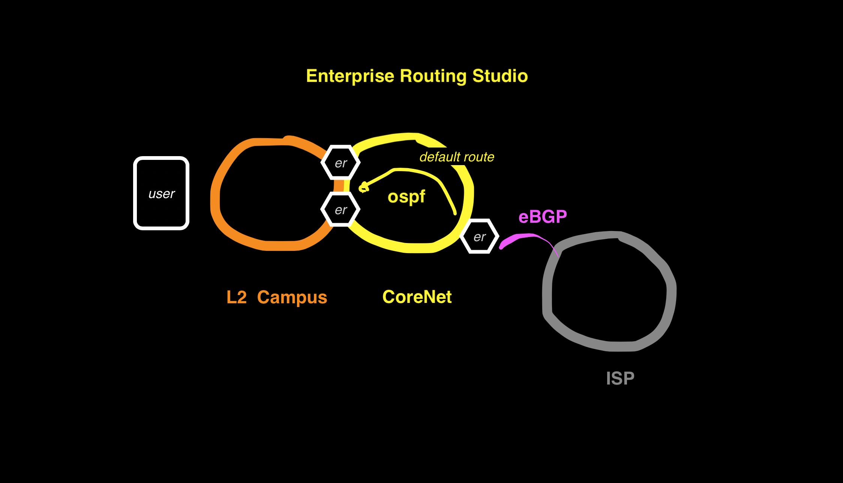
Example1 Campus to ISP

Slide 18
Example1 Campus to ISP BGP and OSPF default route
In this example the Enterprise Routing Studio, consisting of 2 Edge Routers and a Core Router connects Campus to the Internet
ISP sends full routes to border router but only a default route is send into the Enterprise network
MLAG is configured in the Campus Studio and Enterprise Routing Studio so an OSPF adjacency is formed over the MLAG peer link.

Slide 19
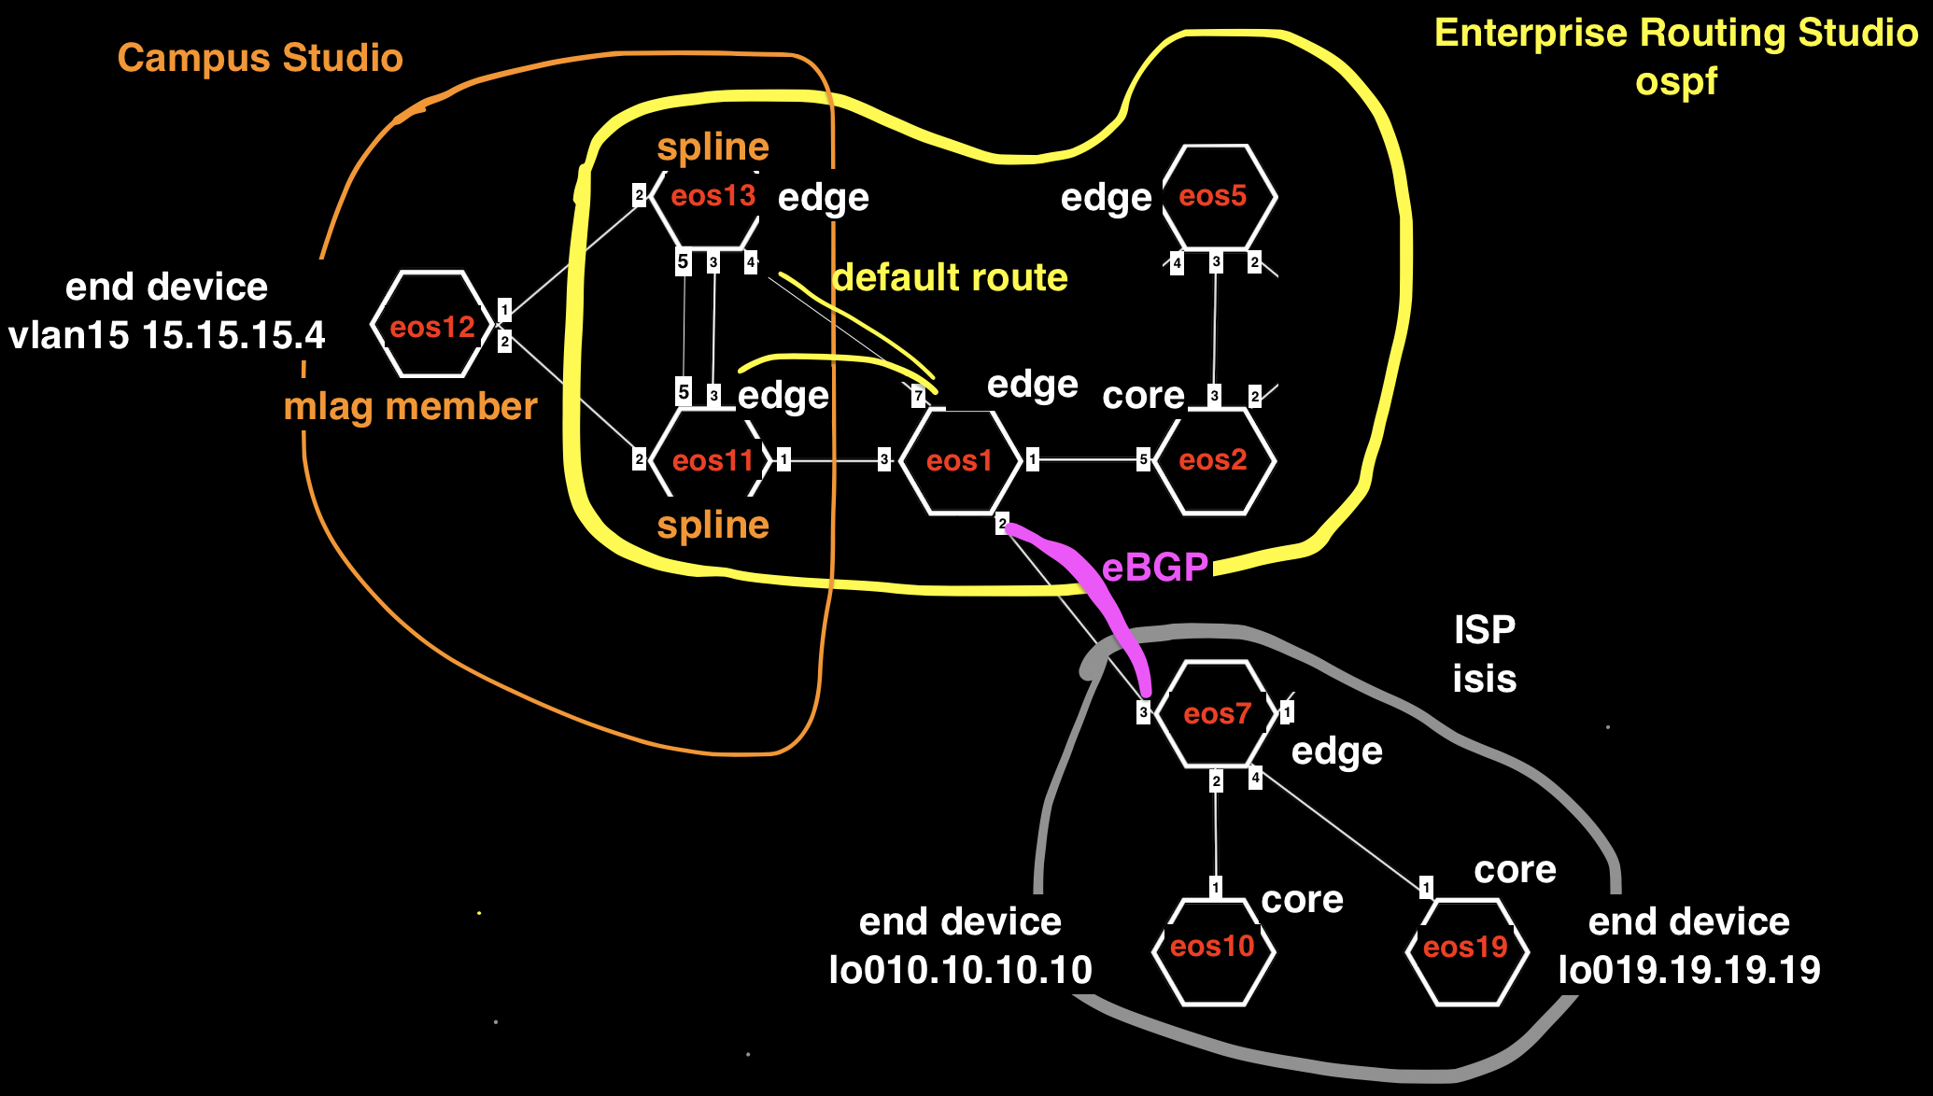
Example1 Detail
core
edge

Slide 20
Example1 Tags
Campus, Campus-eos11-eos12-eos13, eos11
Campus, Campus-eos11-eos12-eos13, eos12
Campus, Campus-eos11-eos12-eos13, eos13
Campus-Pod, 12, eos12
Edge-Router-Domain, 7, eos7
Edge-Router-Domain, Campus11-13, eos11
Edge-Router-Domain, Campus11-13, eos13
Network, Ex1-CoreNet-eos1-eos11-eos13, eos1
Network, Ex1-CoreNet-eos1-eos11-eos13, eos11
Network, Ex1-CoreNet-eos1-eos11-eos13, eos13
Network, ISP-eos7-eos10-eos19, eos10
Network, ISP-eos7-eos10-eos19, eos19
Network, ISP-eos7-eos10-eos19, eos7
Role, Core, eos1
Role, Core, eos10
Role, Core, eos19
Role, Edge-Router, eos11
Role, Edge-Router, eos13
Role, Edge-Router, eos7
router_bgp.as, 7, eos1
router_bgp.as, 7, eos11
router_bgp.as, 7, eos13
router_bgp.as, 8, eos10
router_bgp.as, 8, eos19
router_bgp.as, 8, eos7
router_bgp.router_id, 1.1.1.1, eos1
router_bgp.router_id, 10.10.10.10, eos10
router_bgp.router_id, 11.11.11.11, eos11
router_bgp.router_id, 13.13.13.13, eos13
router_bgp.router_id, 19.19.19.19, eos19
router_bgp.router_id, 7.7.7.7, eos7

Slide 21
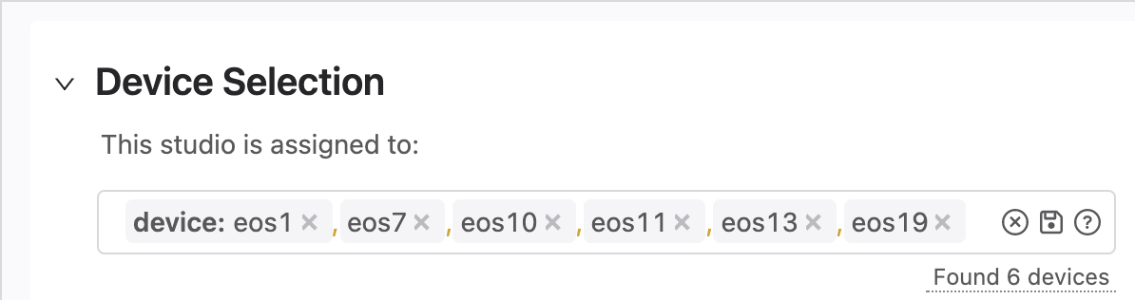
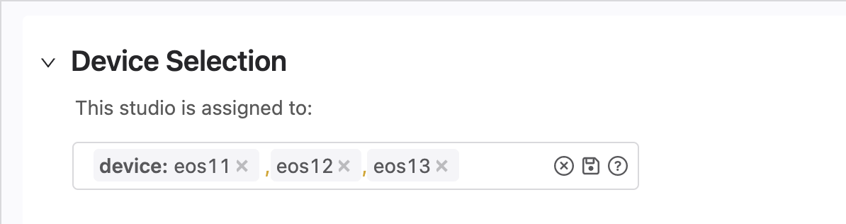
Example1 Device Selection
Enterprise Routing Studio
Campus Studio

Slide 22
Example1 Traffic Test
From Campus switch eos12 ping to eos10 on the ISP network 10.10.10.10 and 19.19.19.19

Slide 23
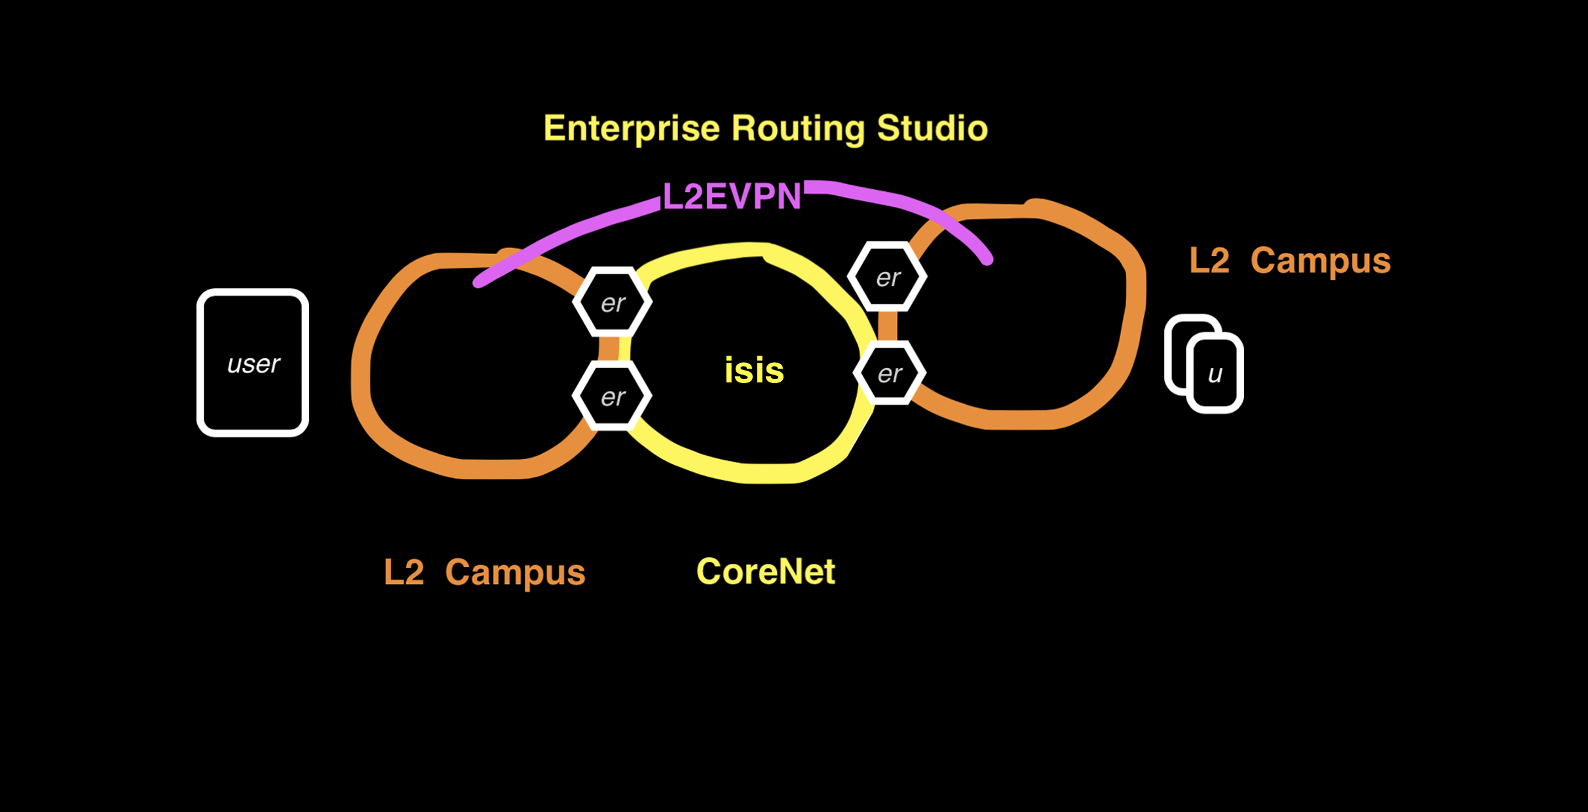
Example2 Campus to Campus EVPN

Slide 24
Example2 Campus to Campus EVPN L2 stretch over the routed Core network
In this example the Enterprise Routing Studio, consisting of 4 Edge Routers and 1 Core Router route a Campus to the Internet
ISP sends full routes but Edge Router sends only a default route to the Campus Splines
Ping from Campus switch eos12 15.15.15.4/24 to eos10 on ISP network 10.10.10.10

Slide 25
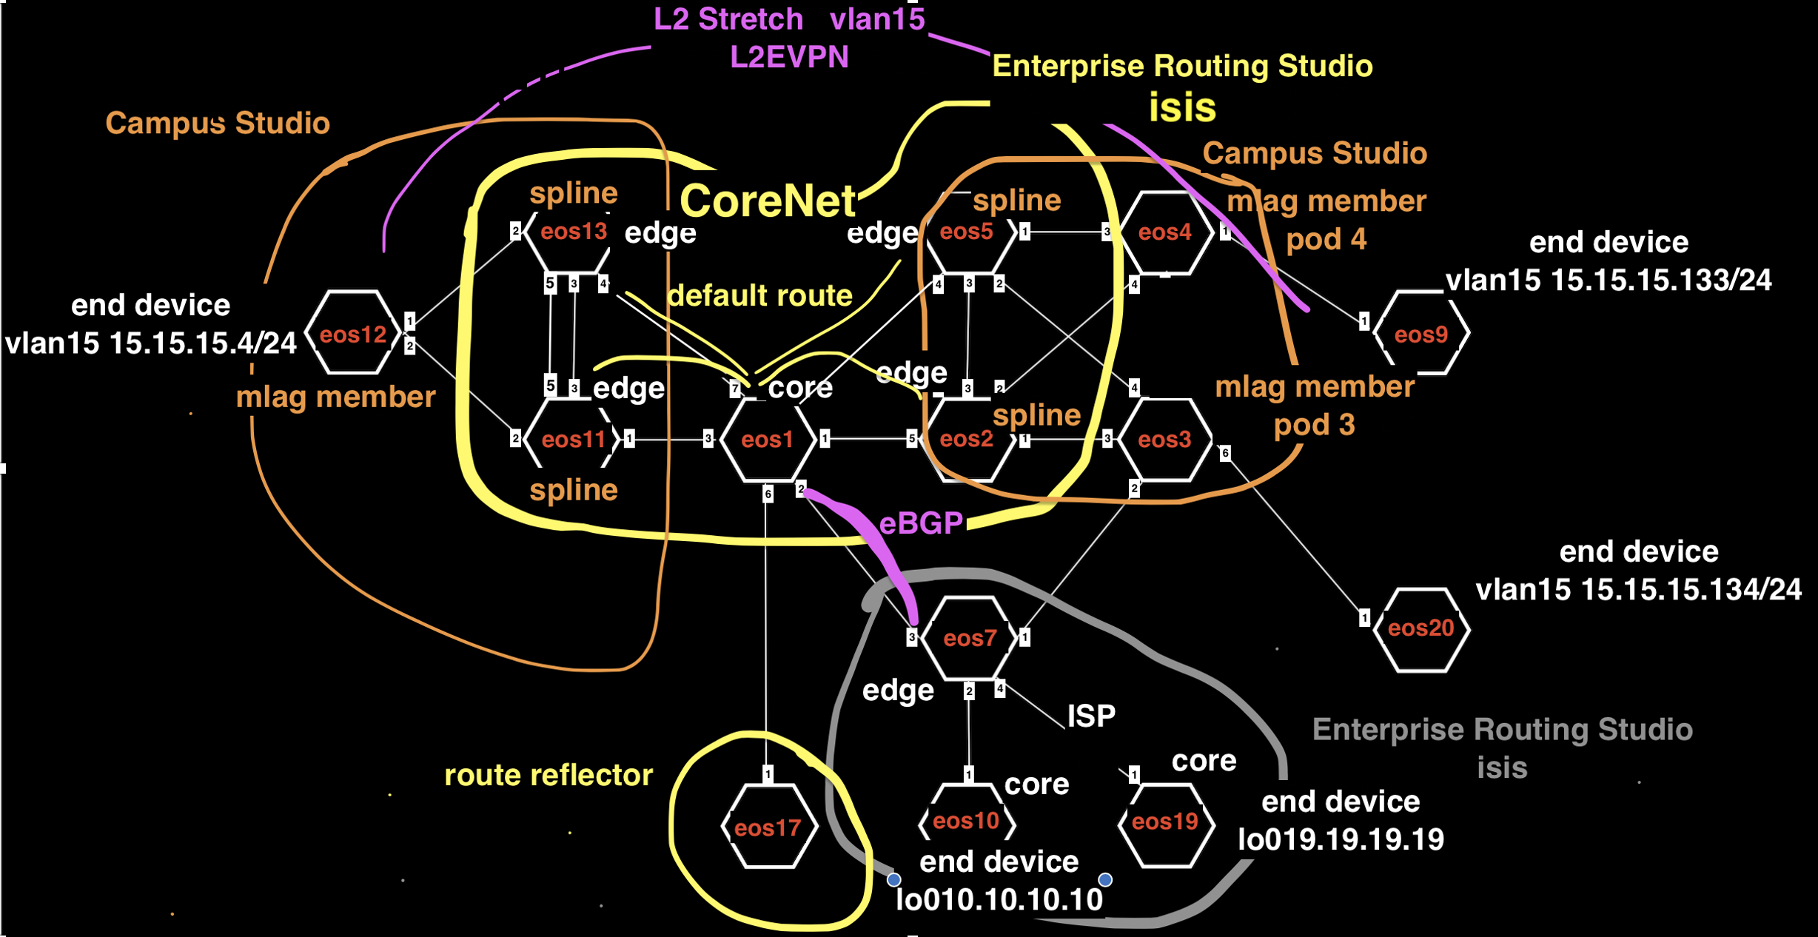
Example2 Detail

Slide 26
Example2 Tags
Campus, Campus-eos11-eos12-eos13, eos11
Campus, Campus-eos11-eos12-eos13, eos12
Campus, Campus-eos11-eos12-eos13, eos13
Campus, Campus-eos2-eos3-eos4-eos5, eos2
Campus, Campus-eos2-eos3-eos4-eos5, eos3
Campus, Campus-eos2-eos3-eos4-eos5, eos4
Campus, Campus-eos2-eos3-eos4-eos5, eos5
Campus-Pod, 12, eos12
Campus-Pod, 3, eos3
Campus-Pod, 4, eos4
Edge-Router-Domain, 20, eos20
Edge-Router-Domain, 7, eos7
Edge-Router-Domain, 9, eos9
Edge-Router-Domain, Campus11-13, eos11
Edge-Router-Domain, Campus11-13, eos13
Edge-Router-Domain, Campus2-5, eos2
Edge-Router-Domain, Campus2-5, eos5
Network, Campus-EndDevice-eos20, eos20
Network, Campus-EndDevice-eos9, eos9
Network, Ex2-CoreNet-eos1-eos2-eos5-eos11-eos13-eos17, eos1
Network, Ex2-CoreNet-eos1-eos2-eos5-eos11-eos13-eos17, eos11
Network, Ex2-CoreNet-eos1-eos2-eos5-eos11-eos13-eos17, eos13
Network, Ex2-CoreNet-eos1-eos2-eos5-eos11-eos13-eos17, eos17
Network, Ex2-CoreNet-eos1-eos2-eos5-eos11-eos13-eos17, eos2
Network, Ex2-CoreNet-eos1-eos2-eos5-eos11-eos13-eos17, eos5
Network, ISP-eos7-eos10-eos19, eos10
Network, ISP-eos7-eos10-eos19, eos19
Network, ISP-eos7-eos10-eos19, eos7
Role, Core, eos1
Role, Core, eos10
Role, Core, eos19
Role, Edge-Router, eos11
Role, Edge-Router, eos13
Role, Edge-Router, eos2
Role, Edge-Router, eos20
Role, Edge-Router, eos5
Role, Edge-Router, eos7
Role, RR, eos17
router_bgp.as, 7, eos1
router_bgp.as, 7, eos11
router_bgp.as, 7, eos13
router_bgp.as, 7, eos17
router_bgp.as, 7, eos2
router_bgp.as, 7, eos5
router_bgp.as, 8, eos10
router_bgp.as, 8, eos19
router_bgp.as, 8, eos7
router_bgp.router_id, 1.1.1.1, eos1
router_bgp.router_id, 10.10.10.10, eos10
router_bgp.router_id, 11.11.11.11, eos11
router_bgp.router_id, 13.13.13.13, eos13
router_bgp.router_id, 17.17.17.17, eos17
router_bgp.router_id, 19.19.19.19, eos19
router_bgp.router_id, 2.2.2.2, eos2
router_bgp.router_id, 5.5.5.5, eos5
router_bgp.router_id, 7.7.7.7, eos7

Slide 27
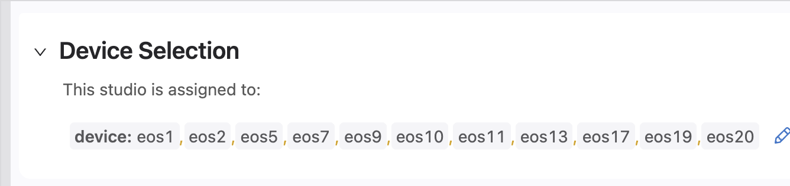
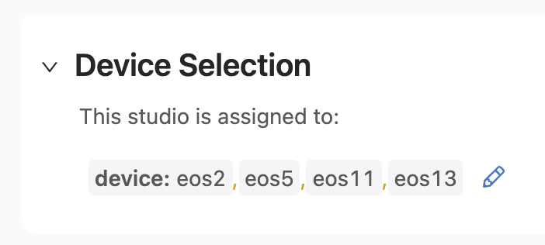
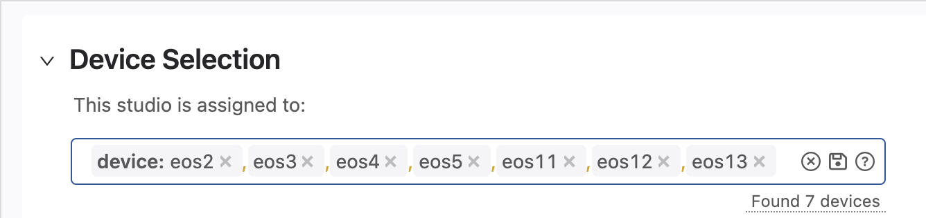
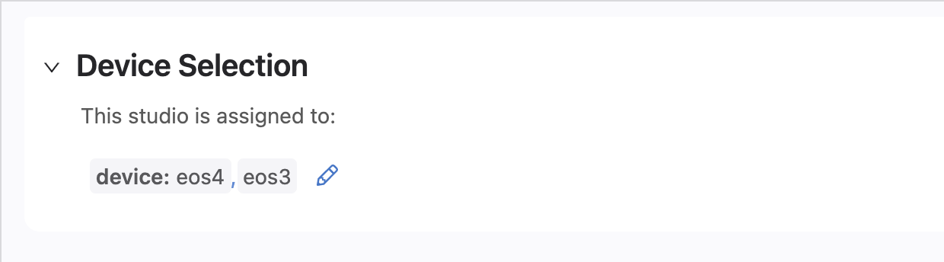
Example2 Device Selection
Enterprise Routing Studio
EVPN Studio
Campus Studio
Interface Configuration Studio

Slide 28
Example2 Interface Studio Ports
Interfaces Studio
Ethernet 1
Ethernet 6
Apply “Trunk” profile to these ports. See slide 15

Slide 29
Example2 Traffic Test
From Campus switch eos12 ping DC end device eos9 15.15.15.133 and eos20 15.15.15.134
From Campus switches eos12, ping to eos10 10.10.10.10 and eos19 19.19.19.19 on the ISP Network
From Campus end devices eos9 and eos20, ping to eos10 10.10.10.10 and eos19 19.19.19.19 on the ISP Network

Slide 30
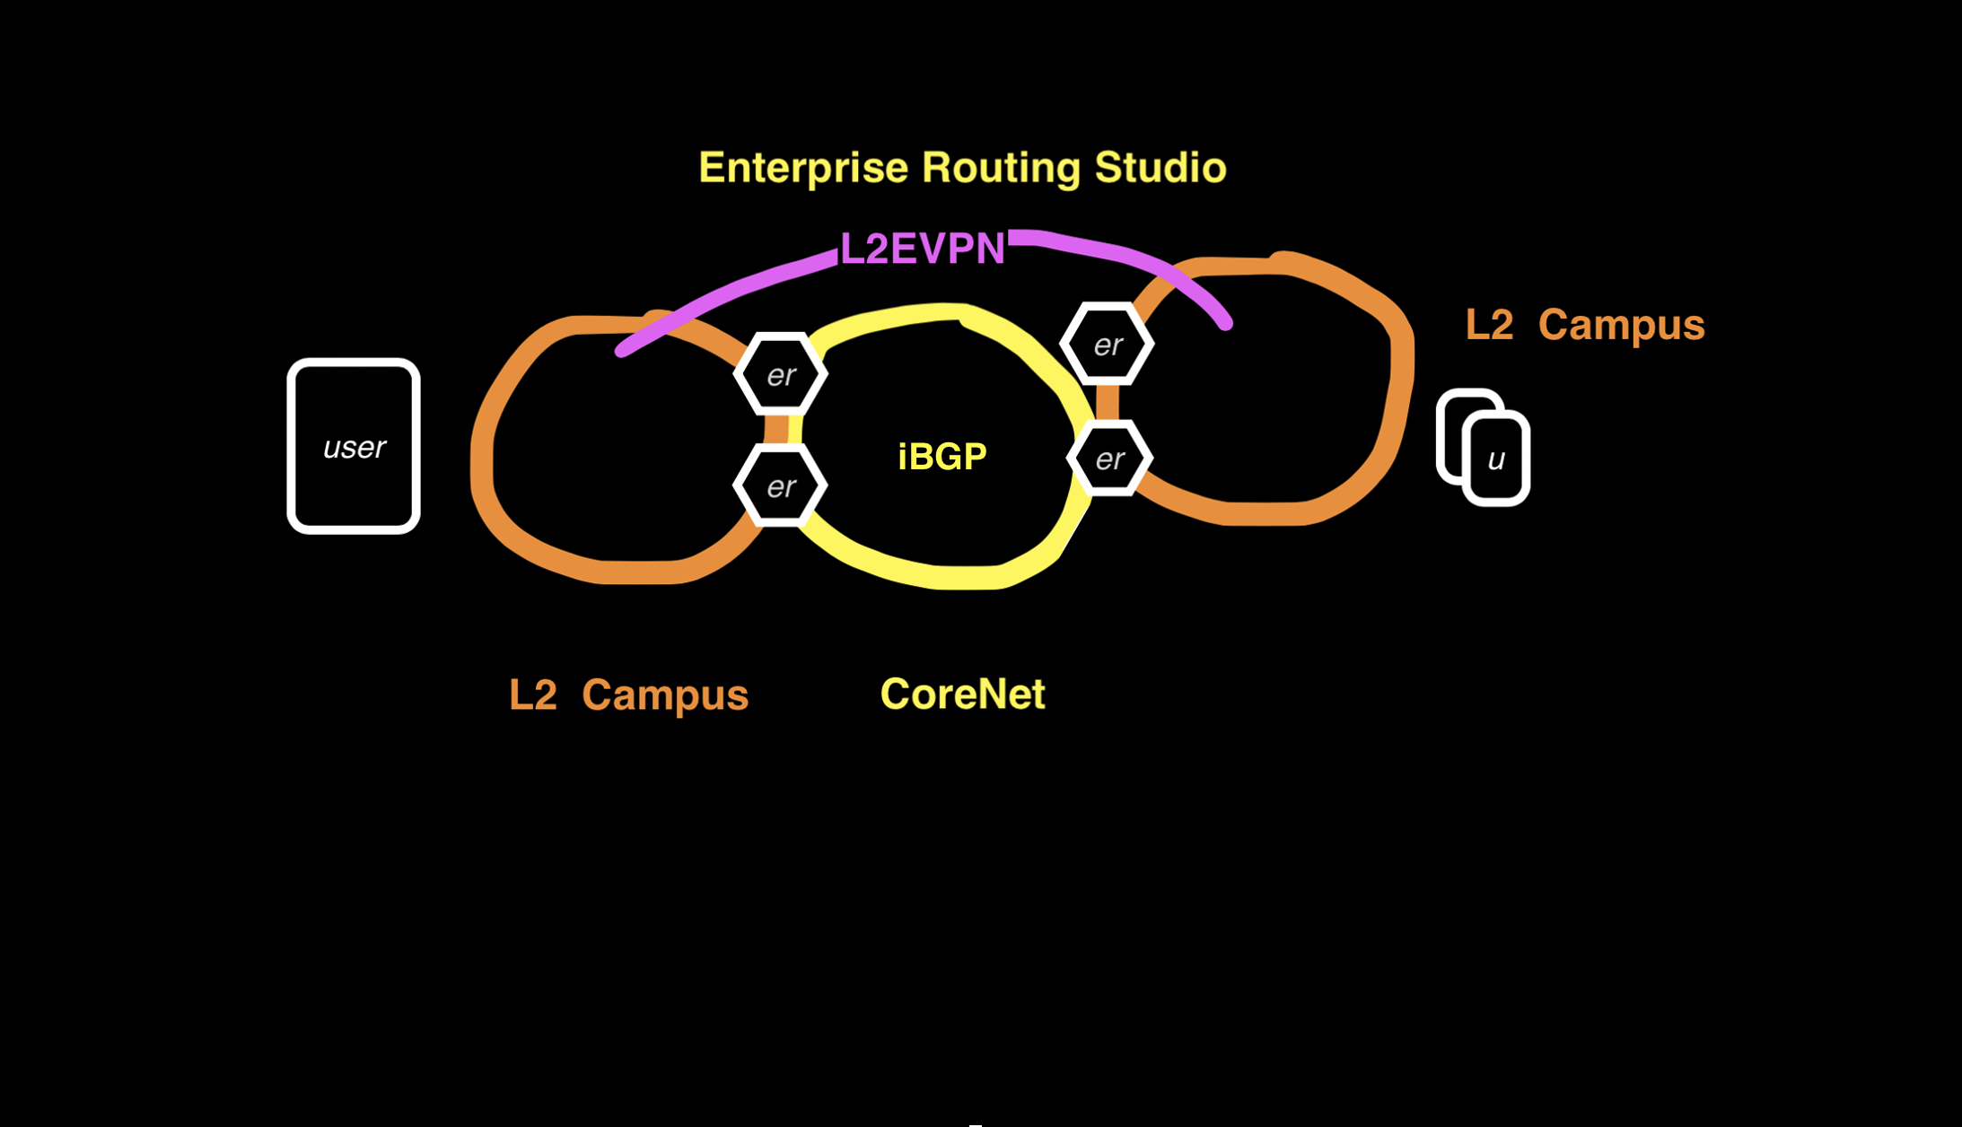
Example3 Campus BGP Underlay

Slide 31
Example3 Campus BGP Underlay L2 stretch over the routed Core network
In this example the Enterprise Routing Studio, consisting of 4 Edge Routers and a Core Router route a Campus to the Internet
ISP sends default route
Ping from Campus switch eos12 15.15.15.4/24 to eos10 on ISP network 10.10.10.10
Note: This example uses “Core Router can also be a RR” feature that came out post Kent

Slide 32
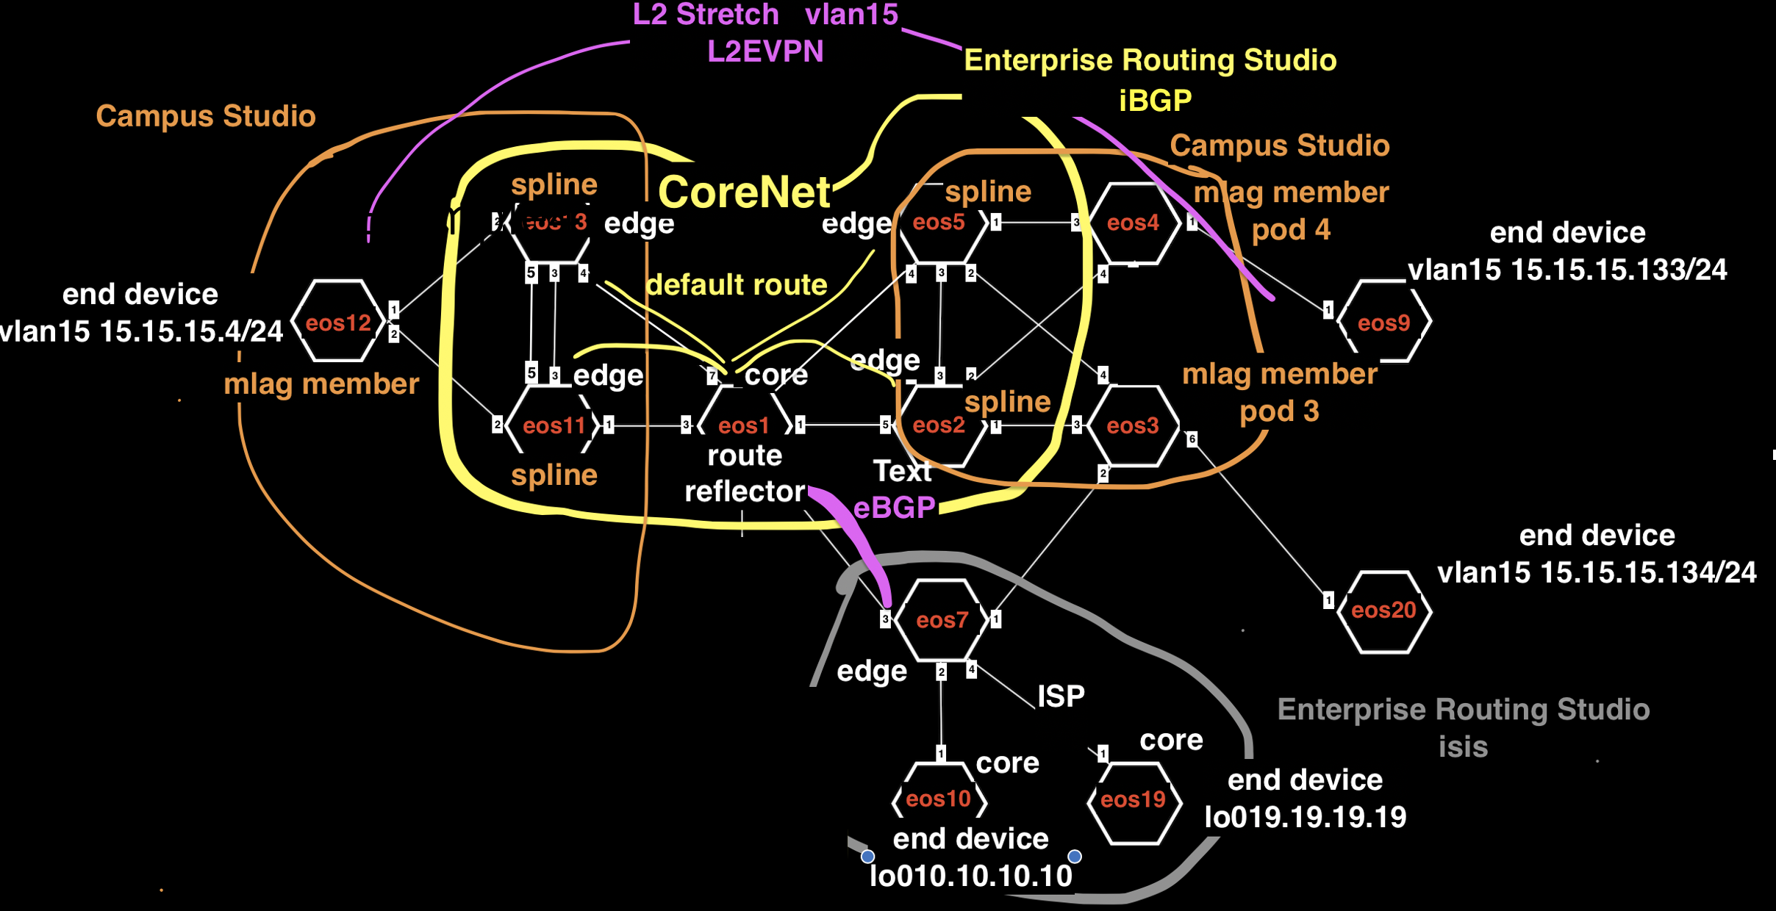
Example3 Detail

Slide 33
Example3 Tags
Campus, Campus-eos11-eos12-eos13, eos11
Campus, Campus-eos11-eos12-eos13, eos12
Campus, Campus-eos11-eos12-eos13, eos13
Campus, Campus-eos2-eos3-eos4-eos5, eos2
Campus, Campus-eos2-eos3-eos4-eos5, eos3
Campus, Campus-eos2-eos3-eos4-eos5, eos4
Campus, Campus-eos2-eos3-eos4-eos5, eos5
Campus-Pod, 12, eos12
Campus-Pod, 3, eos3
Campus-Pod, 4, eos4
Edge-Router-Domain, 20, eos20
Edge-Router-Domain, 7, eos7
Edge-Router-Domain, 9, eos9
Edge-Router-Domain, Campus11-13, eos11
Edge-Router-Domain, Campus11-13, eos13
Edge-Router-Domain, Campus2-5, eos2
Edge-Router-Domain, Campus2-5, eos5
Network, Campus-EndDevice-eos20, eos20
Network, Campus-EndDevice-eos9, eos9
Network, Ex3-CoreNet-eos1-eos2-eos5-eos11-eos13, eos1
Network, Ex3-CoreNet-eos1-eos2-eos5-eos11-eos13, eos11
Network, Ex3-CoreNet-eos1-eos2-eos5-eos11-eos13, eos13
Network, Ex3-CoreNet-eos1-eos2-eos5-eos11-eos13, eos2
Network, Ex3-CoreNet-eos1-eos2-eos5-eos11-eos13, eos5
Network, ISP-eos7-eos10-eos19, eos10
Network, ISP-eos7-eos10-eos19, eos19
Network, ISP-eos7-eos10-eos19, eos7
Role, Core, eos1
Role, Core, eos10
Role, Core, eos19
Role, Edge-Router, eos11
Role, Edge-Router, eos13
Role, Edge-Router, eos2
Role, Edge-Router, eos20
Role, Edge-Router, eos5
Role, Edge-Router, eos7
Role, RR, eos1
router_bgp.as, 7, eos1
router_bgp.as, 7, eos11
router_bgp.as, 7, eos13
router_bgp.as, 7, eos17
router_bgp.as, 7, eos2
router_bgp.as, 7, eos5
router_bgp.as, 8, eos10
router_bgp.as, 8, eos19
router_bgp.as, 8, eos7
router_bgp.router_id, 1.1.1.1, eos1
router_bgp.router_id, 10.10.10.10, eos10
router_bgp.router_id, 11.11.11.11, eos11
router_bgp.router_id, 13.13.13.13, eos13
router_bgp.router_id, 19.19.19.19, eos19
router_bgp.router_id, 2.2.2.2, eos2
router_bgp.router_id, 5.5.5.5, eos5
router_bgp.router_id, 7.7.7.7, eos7

Slide 34
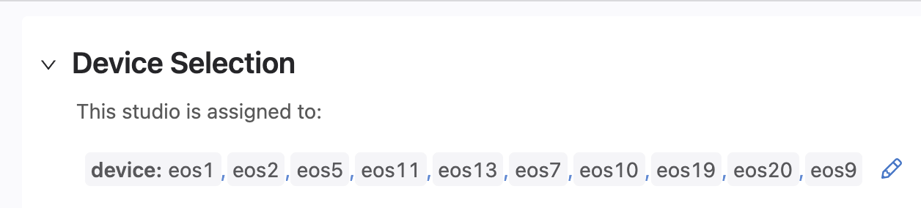
Example3 Device Selection
Enterprise Routing Studio
EVPN Studio
Campus Studio
Interface Configuration Studio

Slide 35
Example3 Interface Studio Ports
Interfaces Studio
Ethernet 1
Ethernet 6
Apply “Trunk” profile to these ports. See slide 15

Slide 36
Example3 Traffic Test
From Campus switch eos12 ping DC end device eos9 15.15.15.133 and eos20 15.15.15.134
From Campus switches eos12, ping to eos10 10.10.10.10 and eos19 19.19.19.19 on the ISP Network
From Campus end devices eos9 and eos20, ping to eos10 10.10.10.10 and eos19 19.19.19.19 on the ISP Network

Slide 37
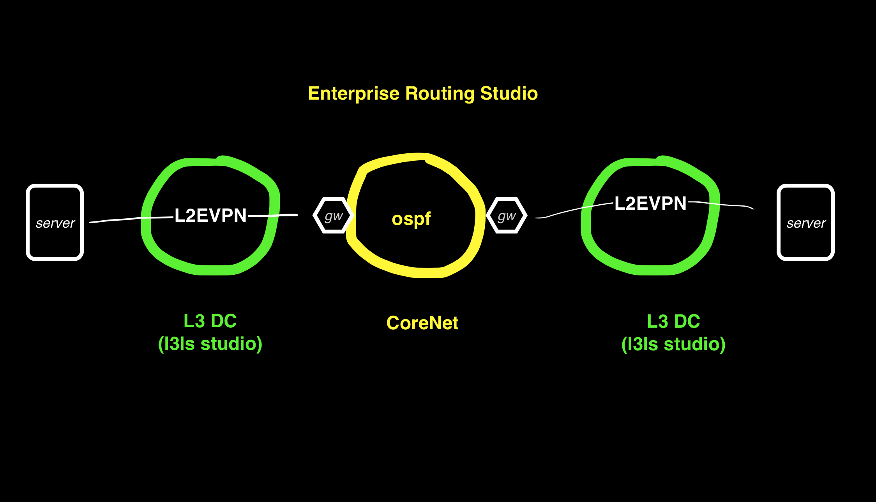
Example4 DC Gateway Router

Slide 38
Example4 DC Gateway Router This example also routes between DCs with OSPF
In this example the Enterprise Routing Studio, consisting of a Core Router and 2 Edge Routers, connects 2 DC together
The DC border leafs have a trunk port to Edge Router and another leaf has a trunk to the end device
A vlan in 1 DC containing the end device is routed to a different vlan in another DC
Each vlan is a L2 EVPN in Each DC with the end device and the Edge Router in the VPN.
The Edge Router is the default gw for end devices in each DC. (A switch is used for the end device to launch pings from)
Example2 and example3 build on example 1

Slide 39
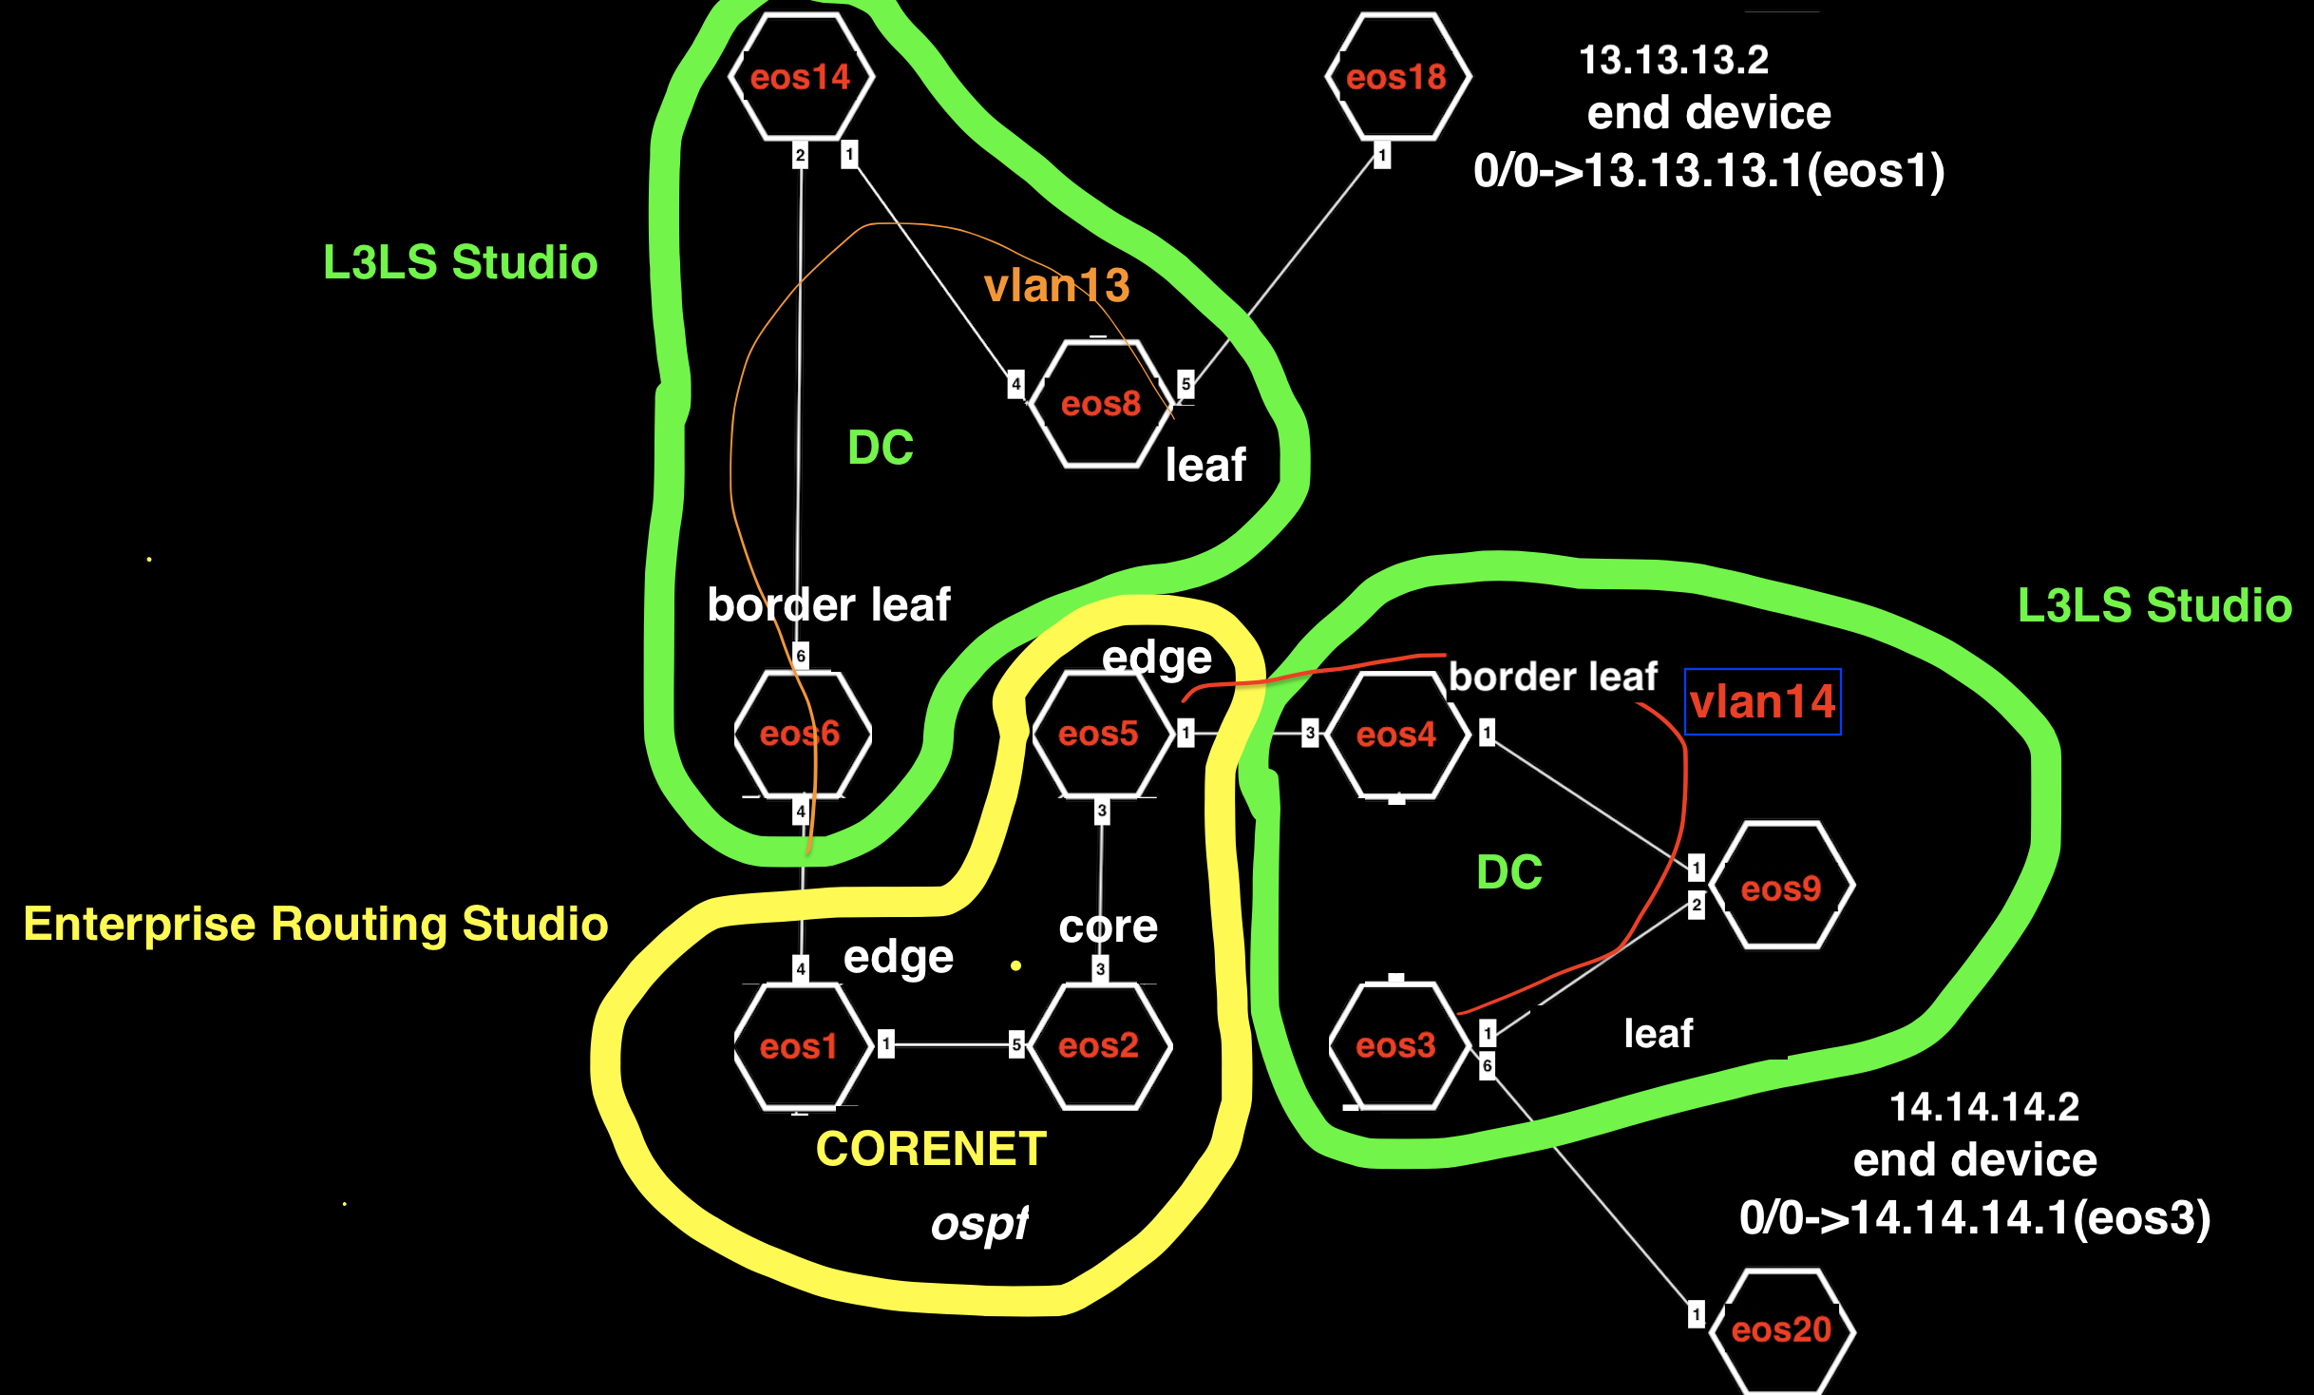
Example4 Detail

Slide 40
Example4 Tags
DC, DC-eos3-eos4-eos9, eos3
DC, DC-eos3-eos4-eos9, eos4
DC, DC-eos3-eos4-eos9, eos9
DC, DC-eos6-eos8-eos14, eos14
DC, DC-eos6-eos8-eos14, eos6
DC, DC-eos6-eos8-eos14, eos8
DC-Pod, 1, eos14
DC-Pod, 1, eos6
DC-Pod, 1, eos8
DC-Pod, 2, eos3
DC-Pod, 2, eos4
DC-Pod, 2, eos9
Edge-Router-Domain, 1, eos1
Edge-Router-Domain, 18, eos18
Edge-Router-Domain, 20, eos20
Edge-Router-Domain, 5, eos5
Leaf-Domain, 1, eos6
Leaf-Domain, 2, eos8
Leaf-Domain, 3, eos3
Leaf-Domain, 4, eos4
Leaf-Number, 1, eos4
Leaf-Number, 1, eos6
Leaf-Number, 2, eos3
Leaf-Number, 2, eos8
Network, DC-End-device-eos18, eos18
Network, DC-End-device-eos20, eos20
Network, Ex4-CoreNet-eos1-eos2-eos5, eos1
Network, Ex4-CoreNet-eos1-eos2-eos5, eos2
Network, Ex4-CoreNet-eos1-eos2-eos5, eos5
Role, Core, eos2
Role, Edge-Router, eos1
Role, Edge-Router, eos5
Role, Leaf, eos3
Role, Leaf, eos4
Role, Leaf, eos6
Role, Leaf, eos8
Role, Spine, eos14
Role, Spine, eos9
Spine-Number, 1, eos14
Spine-Number, 1, eos9
router_bgp.as, 65000, eos14
router_bgp.as, 65001, eos6
router_bgp.as, 65002, eos8
router_bgp.as, 65010, eos9
router_bgp.as, 65013, eos3
router_bgp.as, 65014, eos4
router_bgp.as, 7, eos1
router_bgp.as, 7, eos2
router_bgp.as, 7, eos5
router_bgp.router_id, 1.1.1.1, eos1
router_bgp.router_id, 172.16.0.1, eos14
router_bgp.router_id, 172.16.0.1, eos9
router_bgp.router_id, 172.16.0.2, eos4
router_bgp.router_id, 172.16.0.2, eos6
router_bgp.router_id, 172.16.0.3, eos3
router_bgp.router_id, 172.16.0.3, eos8
router_bgp.router_id, 2.2.2.2, eos2
router_bgp.router_id, 5.5.5.5, eos5

Slide 41
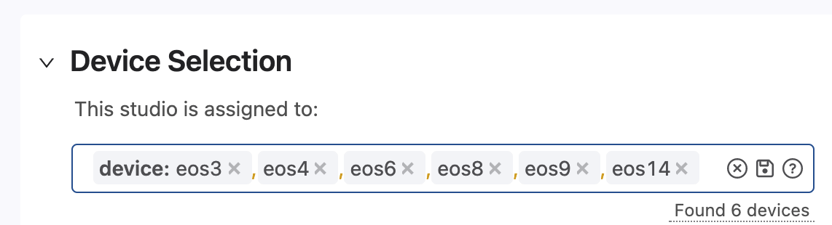
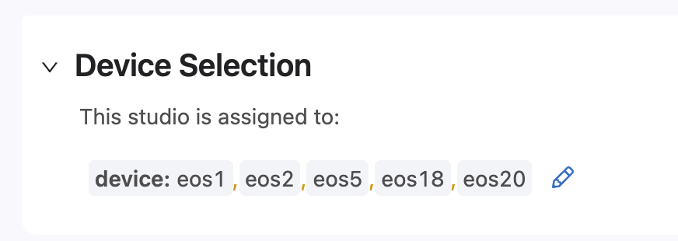
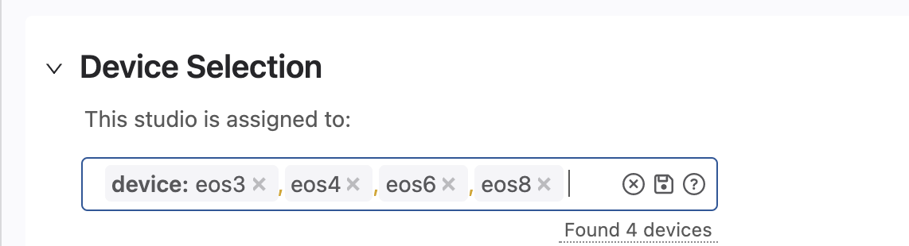
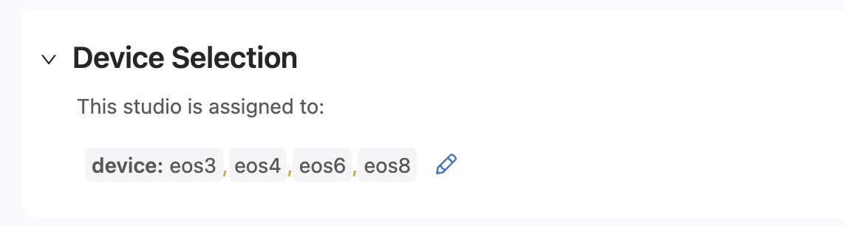
Example4 Device Selection
Enterprise Routing Studio
L3LS Studio
EVPN Studio
Interfaces Studio

Slide 42
Example4 Interface Studio Ports
Interfaces Studio
Ethernet 6
Ethernet 3
Ethernet 4
Ethernet 5
Apply “Trunk” profile to these ports. See slide 15

Slide 43
Example4 Traffic Test
From eos18 ping to eos20 14.14.14.2

Slide 44
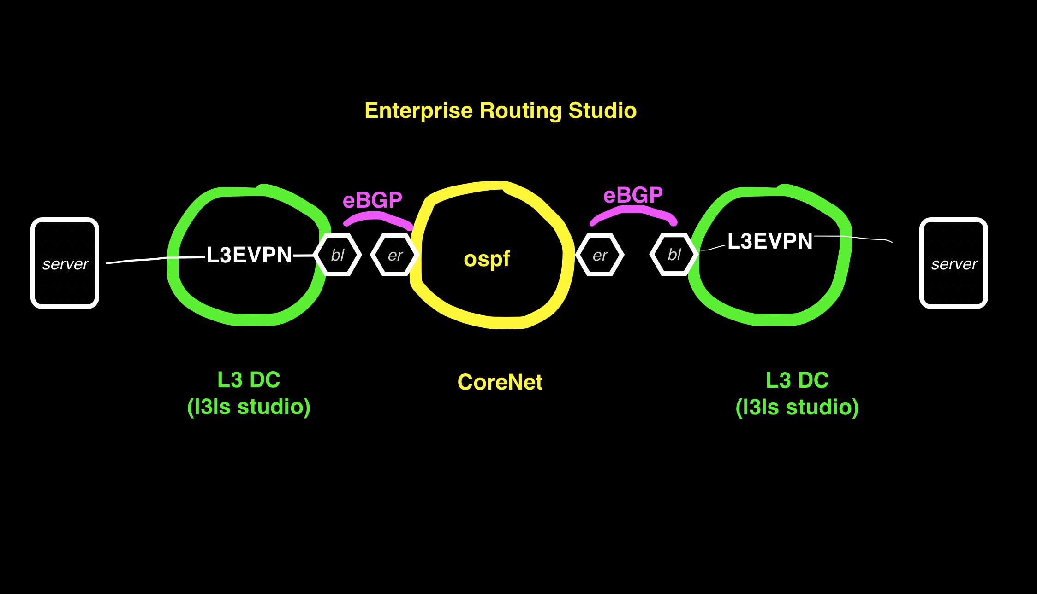
Example5 BGP DC Interconnect

Slide 45
Example5 BGP DC Interconnect DCs route to each other in this example
In this example the Enterprise Routing Studio, consisting of a Core Router and 2 Edge Routers, connects 2 DC together
The DC border leafs have a trunk port to Edge Router and another leaf has a trunk to the end device
A vlan in 1 DC containing the end device is routed to a different vlan in another DC
Each vlan is a L3 EVPN in Each DC with the end device and the Edge Router in the VPN.
The Edge Router is the default gw for end devices in each DC. (A switch is used for the end device to ping from)
Ping from eos18 13.13.13.2/24 to eos 20 14.14.14.2/24

Slide 46
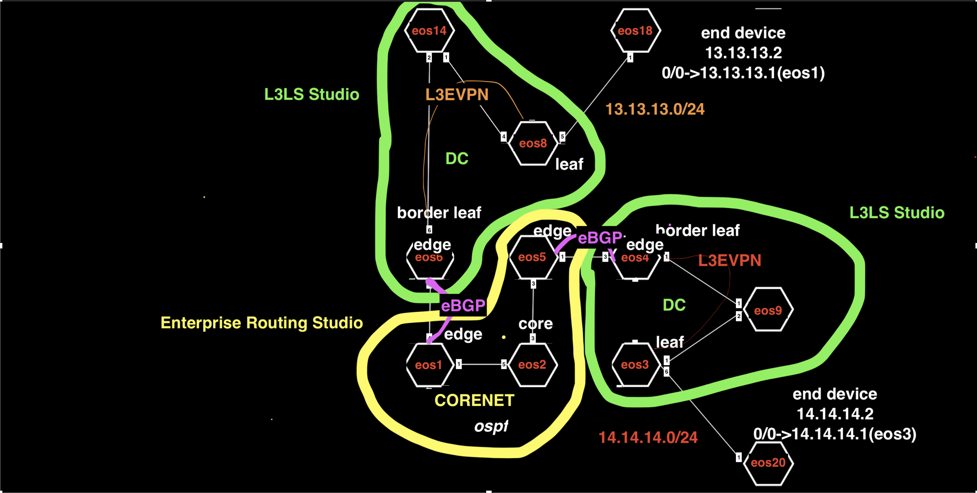
Example5 Detail

Slide 47
Example5 Tags
DC, DC-eos3-eos4-eos9, eos3
DC, DC-eos3-eos4-eos9, eos4
DC, DC-eos3-eos4-eos9, eos9
DC, DC-eos6-eos8-eos14, eos14
DC, DC-eos6-eos8-eos14, eos6
DC, DC-eos6-eos8-eos14, eos8
DC-Pod, 1, eos14
DC-Pod, 1, eos6
DC-Pod, 1, eos8
DC-Pod, 2, eos3
DC-Pod, 2, eos4
DC-Pod, 2, eos9
Edge-Router-Domain, 1, eos1
Edge-Router-Domain, 18, eos18
Edge-Router-Domain, 20, eos20
Edge-Router-Domain, 4, eos4
Edge-Router-Domain, 5, eos5
Edge-Router-Domain, 6, eos6
Leaf-Domain, 1, eos6
Leaf-Domain, 2, eos8
Leaf-Domain, 3, eos3
Leaf-Domain, 4, eos4
Leaf-Number, 1, eos4
Leaf-Number, 1, eos6
Leaf-Number, 2, eos3
Leaf-Number, 2, eos8
Network, DC-Border-Leaf-eos4, eos4
Network, DC-Border-Leaf-eos6, eos6
Network, DC-End-device-eos18, eos18
Network, DC-End-device-eos20, eos20
Network, Ex5-CoreNet-eos1-eos2-eos5, eos1
Network, Ex5-CoreNet-eos1-eos2-eos5, eos2
Network, Ex5-CoreNet-eos1-eos2-eos5, eos5
Role, Core, eos2
Role, Edge-Router, eos1
Role, Edge-Router, eos5
Role, Leaf, eos3
Role, Leaf, eos4
Role, Leaf, eos6
Role, Leaf, eos8
Role, Spine, eos14
Role, Spine, eos9
Spine-Number, 1, eos14
Spine-Number, 1, eos9
router_bgp.as, 65000, eos14
router_bgp.as, 65001, eos6
router_bgp.as, 65002, eos8
router_bgp.as, 65010, eos9
router_bgp.as, 65013, eos3
router_bgp.as, 65014, eos4
router_bgp.as, 7, eos1
router_bgp.as, 7, eos2
router_bgp.as, 7, eos5
router_bgp.router_id, 1.1.1.1, eos1
router_bgp.router_id, 172.16.0.1, eos14
router_bgp.router_id, 172.16.0.1, eos9
router_bgp.router_id, 172.16.0.2, eos4
router_bgp.router_id, 172.16.0.2, eos6
router_bgp.router_id, 172.16.0.3, eos3
router_bgp.router_id, 172.16.0.3, eos8
router_bgp.router_id, 2.2.2.2, eos2
router_bgp.router_id, 5.5.5.5, eos5

Slide 48
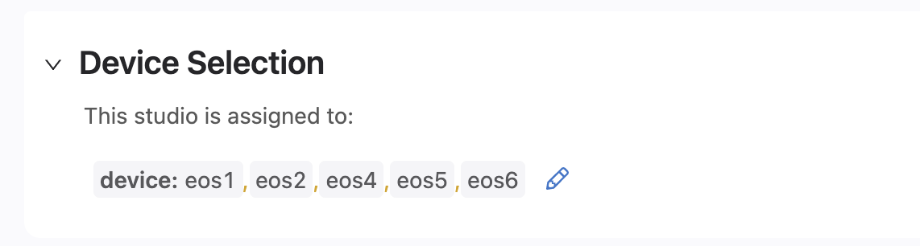
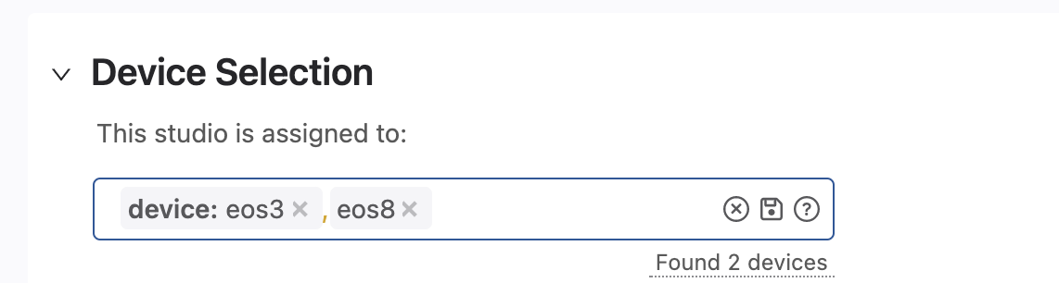
Example5 Device Selection
Enterprise Routing Studio
L3LS Studio
EVPN Studio
Interfaces Studio

Slide 49
Example5 Interface Studio Ports
Interfaces Studio
Ethernet 6
Ethernet 5
Apply “Trunk” profile to these ports. See slide 15

Slide 50
Example5 Traffic Test
From eos18 ping eos20 14.14.14.2
You may have to clear the arp cache on eos18 between the mac address of its default gateway has changed from the previous example

Slide 51
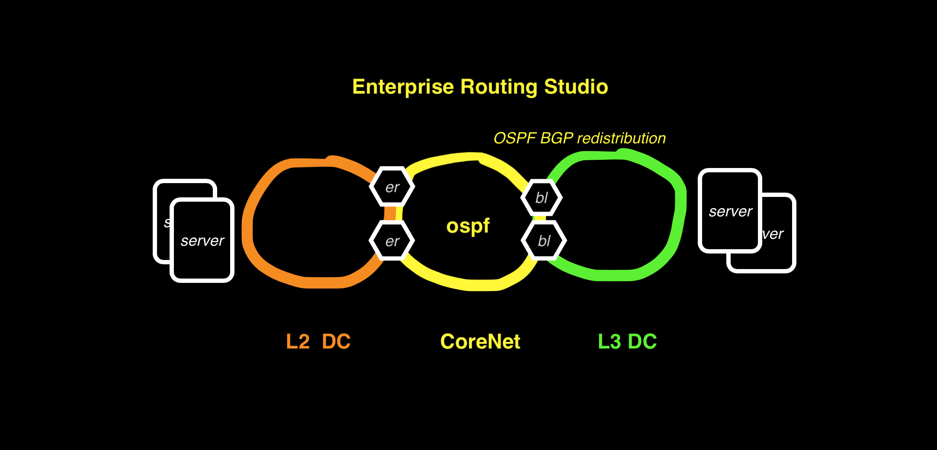
Example6 OSPF on DC Border Leaf

Slide 52
Example6 OSPF on DC Border Leaf L3DC has no overlay and mutual redistribution of BGP and OSPF routes.
In this example the Enterprise Routing Studio, consisting of 4 Edge Routers and 2 Core Routers routes a L3DC using L3LS Studio to an L2 DC using the Campus Studio.
On the border leafs on the L3 DC BGP to OSPF redistribution is configured using the Enterprise Routing Studio
Border Leafs are set to the same ASN in the L3LS Studio to prevent routing loops

Slide 53
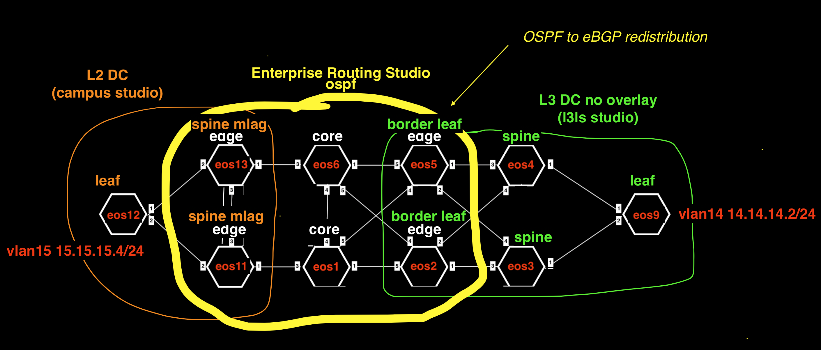
Example6 Detail

Slide 54
Example6 Tags
Campus, L2DC-eos11-eos12-eos13, eos11
Campus, L2DC-eos11-eos12-eos13, eos12
Campus, L2DC-eos11-eos12-eos13, eos13
Campus, L3DC-End-device-eos9, eos9
Campus-Pod, L2DC-eos12, eos12
DC, L3DC-eos2-eos3-eos4-eos5-eos9, eos2
DC, L3DC-eos2-eos3-eos4-eos5-eos9, eos3
DC, L3DC-eos2-eos3-eos4-eos5-eos9, eos4
DC, L3DC-eos2-eos3-eos4-eos5-eos9, eos5
DC, L3DC-eos2-eos3-eos4-eos5-eos9, eos9
DC-Pod, 1, eos2
DC-Pod, 1, eos3
DC-Pod, 1, eos4
DC-Pod, 1, eos5
DC-Pod, 1, eos9
Edge-Router-Domain, 11-13, eos11
Edge-Router-Domain, 11-13, eos13
Edge-Router-Domain, 2, eos2
Edge-Router-Domain, 5, eos5
Edge-Router-Domain, 9, eos9
Leaf-Domain, 2, eos2
Leaf-Domain, 5, eos5
Leaf-Domain, 9, eos9
Leaf-Number, 1, eos2
Leaf-Number, 2, eos5
Leaf-Number, 3, eos9
Network, Ex6-CoreNet-eos1-eos2-eos5-eos6-eos11-eos13, eos1
Network, Ex6-CoreNet-eos1-eos2-eos5-eos6-eos11-eos13, eos11
Network, Ex6-CoreNet-eos1-eos2-eos5-eos6-eos11-eos13, eos13
Network, Ex6-CoreNet-eos1-eos2-eos5-eos6-eos11-eos13, eos2
Network, Ex6-CoreNet-eos1-eos2-eos5-eos6-eos11-eos13, eos5
Network, Ex6-CoreNet-eos1-eos2-eos5-eos6-eos11-eos13, eos6
Network, L3DC-End-device-eos9, eos9
Role, Core, eos1
Role, Core, eos6
Role, Edge-Router, eos11
Role, Edge-Router, eos13
Role, Edge-Router, eos2
Role, Edge-Router, eos5
Role, Leaf, eos2
Role, Leaf, eos5
Role, Leaf, eos9
Role, Spine, eos3
Role, Spine, eos4
Spine-Number, 1, eos4
Spine-Number, 2, eos3
router_bgp.as, 65000, eos3
router_bgp.as, 65000, eos4
router_bgp.as, 65001, eos2
router_bgp.as, 65001, eos5
router_bgp.as, 65009, eos9
router_bgp.router_id, 1.1.1.1, eos1
router_bgp.router_id, 11.11.11.11, eos11
router_bgp.router_id, 13.13.13.13, eos13
router_bgp.router_id, 172.16.0.1, eos4
router_bgp.router_id, 172.16.0.2, eos3
router_bgp.router_id, 172.16.0.3, eos2
router_bgp.router_id, 172.16.0.4, eos5
router_bgp.router_id, 172.16.0.5, eos9
router_bgp.router_id, 6.6.6.6, eos6

Slide 55
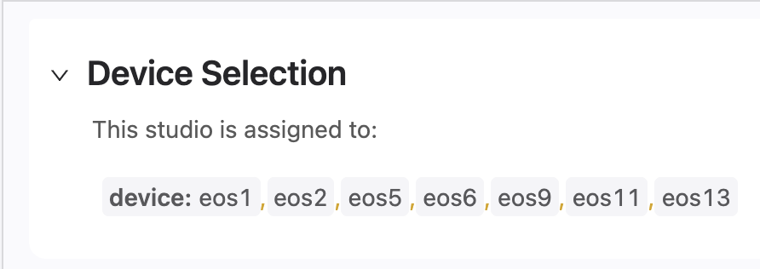
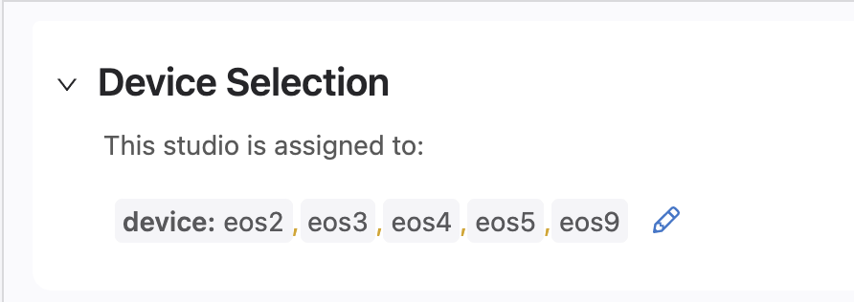
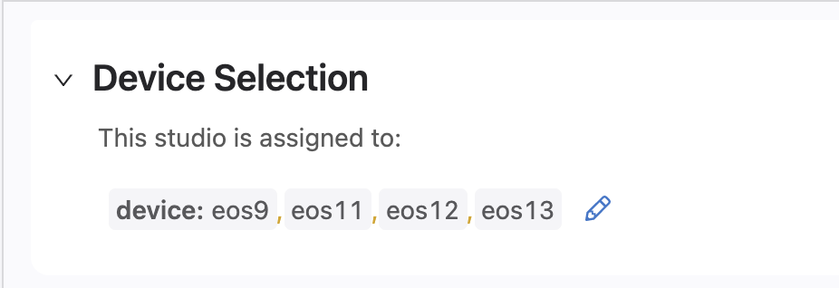
Example6 Device Selection
Enterprise Routing Studio
L3LS Studio
Campus Studio

Slide 56
Example6 Traffic Test
From Campus switch eos12 ping DC Leaf eos9 14.14.14.2
From DC Leaf eos9 14.14.14.2 ping Campus switch eos12

Slide 57
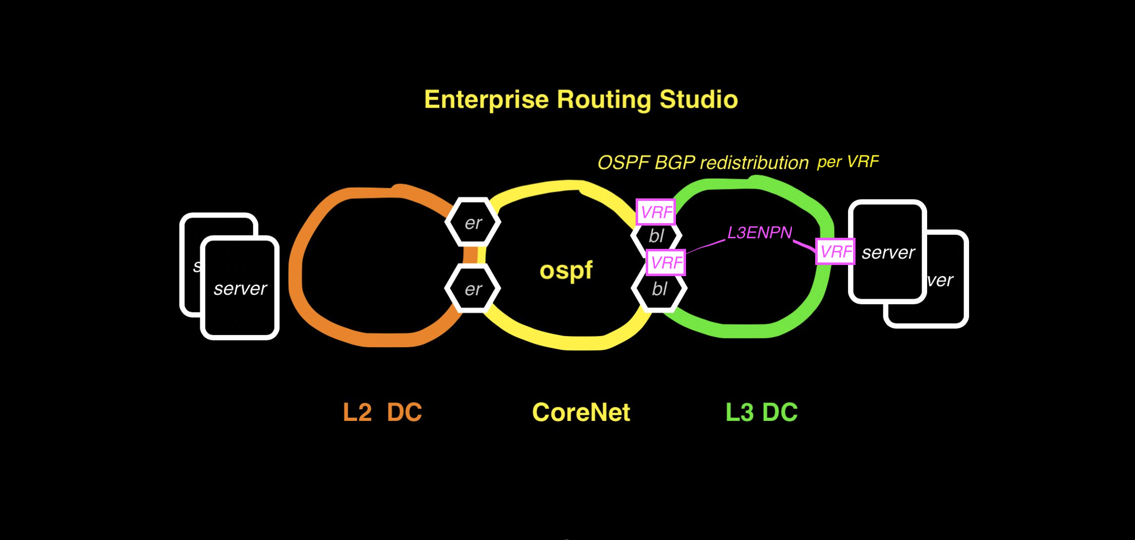
Example7 DC Border Leaf OSPF per VRF

Slide 58
Example7 DC Border Leaf OSPF per VRF L3 DC has EVPN overlay and runs OSPF on Border Leafs in VRF
In this example the Enterprise Routing Studio, consisting of 4 Edge Routers and 2 Core Routers routes a L3DC using L3LS Studio to an L2 DC using the Campus Studio.
On the border leafs on the L3 DC BGP to OSPF redistribution is configured using the Enterprise Routing Studio
Border Leafs are set to the same ASN in the L3LS Studio to prevent routing loops

Slide 59
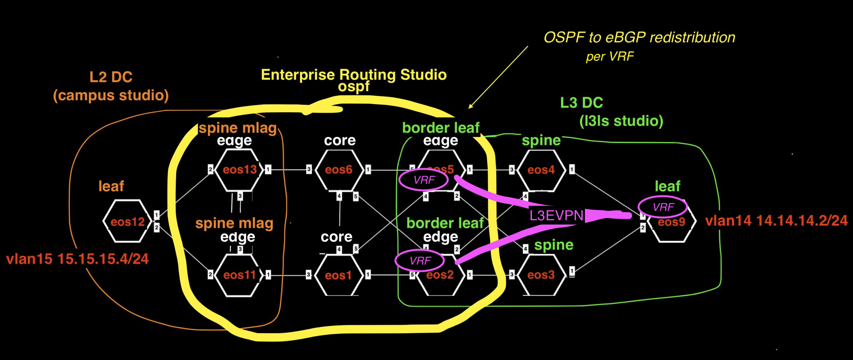
Example7 Detail

Slide 60
Example7 Tags
Campus, L2DC-eos11-eos12-eos13, eos11
Campus, L2DC-eos11-eos12-eos13, eos12
Campus, L2DC-eos11-eos12-eos13, eos13
Campus, L3DC-End-device-eos9, eos9
Campus-Pod, L2DC-eos12, eos12
DC, L3DC-eos2-eos3-eos4-eos5-eos9, eos2
DC, L3DC-eos2-eos3-eos4-eos5-eos9, eos3
DC, L3DC-eos2-eos3-eos4-eos5-eos9, eos4
DC, L3DC-eos2-eos3-eos4-eos5-eos9, eos5
DC, L3DC-eos2-eos3-eos4-eos5-eos9, eos9
DC-Pod, 1, eos2
DC-Pod, 1, eos3
DC-Pod, 1, eos4
DC-Pod, 1, eos5
DC-Pod, 1, eos9
Edge-Router-Domain, 11-13, eos11
Edge-Router-Domain, 11-13, eos13
Edge-Router-Domain, 2, eos2
Edge-Router-Domain, 5, eos5
Edge-Router-Domain, 9, eos9
Leaf-Domain, 2, eos2
Leaf-Domain, 5, eos5
Leaf-Domain, 9, eos9
Leaf-Number, 1, eos2
Leaf-Number, 2, eos5
Leaf-Number, 3, eos9
Network, Ex7-CoreNet-eos1-eos2-eos5-eos6-eos11-eos13, eos1
Network, Ex7-CoreNet-eos1-eos2-eos5-eos6-eos11-eos13, eos11
Network, Ex7-CoreNet-eos1-eos2-eos5-eos6-eos11-eos13, eos13
Network, Ex7-CoreNet-eos1-eos2-eos5-eos6-eos11-eos13, eos2
Network, Ex7-CoreNet-eos1-eos2-eos5-eos6-eos11-eos13, eos5
Network, Ex7-CoreNet-eos1-eos2-eos5-eos6-eos11-eos13, eos6
Network, L3DC-End-device-eos9, eos9
Role, Core, eos1
Role, Core, eos6
Role, Edge-Router, eos11
Role, Edge-Router, eos13
Role, Edge-Router, eos2
Role, Edge-Router, eos5
Role, Leaf, eos2
Role, Leaf, eos5
Role, Leaf, eos9
Role, Spine, eos3
Role, Spine, eos4
Spine-Number, 1, eos4
Spine-Number, 2, eos3
router_bgp.as, 65000, eos3
router_bgp.as, 65000, eos4
router_bgp.as, 65001, eos2
router_bgp.as, 65001, eos5
router_bgp.as, 65009, eos9
router_bgp.router_id, 1.1.1.1, eos1
router_bgp.router_id, 11.11.11.11, eos11
router_bgp.router_id, 13.13.13.13, eos13
router_bgp.router_id, 172.16.0.1, eos4
router_bgp.router_id, 172.16.0.2, eos3
router_bgp.router_id, 172.16.0.3, eos2
router_bgp.router_id, 172.16.0.4, eos5
router_bgp.router_id, 172.16.0.5, eos9
router_bgp.router_id, 6.6.6.6, eos6
➜ ~
Notes:
Role, Core, eos1
Role, Core, eos6
Role, Edge-Router, eos11
Role, Edge-Router, eos13
Role, Edge-Router, eos2
Role, Edge-Router, eos5
Role, Leaf, eos2
Role, Leaf, eos5
Role, Leaf, eos9
Role, Spine, eos3
Role, Spine, eos4
Spine-Number, 1, eos4
Spine-Number, 2, eos3
router_bgp.as, 65000, eos3
router_bgp.as, 65000, eos4
router_bgp.as, 65001, eos2
router_bgp.as, 65001, eos5
router_bgp.as, 65009, eos9
router_bgp.router_id, 1.1.1.1, eos1
router_bgp.router_id, 11.11.11.11, eos11
router_bgp.router_id, 13.13.13.13, eos13
router_bgp.router_id, 172.16.0.1, eos4
router_bgp.router_id, 172.16.0.2, eos3
router_bgp.router_id, 172.16.0.3, eos2
router_bgp.router_id, 172.16.0.4, eos5
router_bgp.router_id, 172.16.0.5, eos9
router_bgp.router_id, 6.6.6.6, eos6
➜ ~

Slide 61
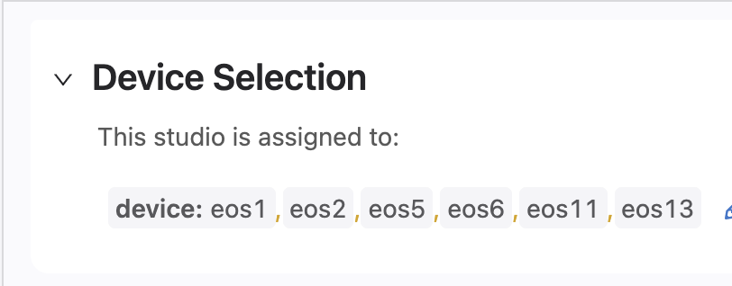
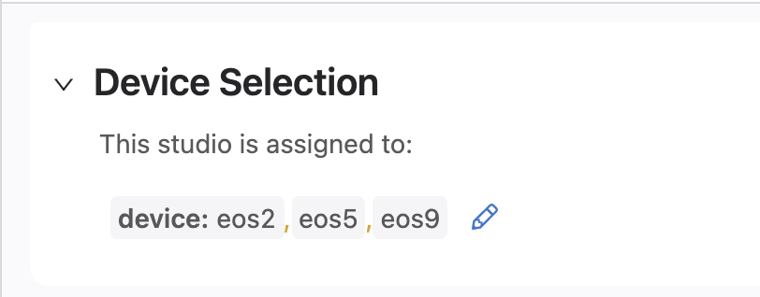
Example7 Device Selection
Enterprise Routing Studio
L3LS Studio
Campus Studio
EVPN Studio

Slide 62
Example7 Traffic Test
From Campus switch eos12 ping DC Leaf eos9 14.14.14.2
From DC Leaf eos9 14.14.14.2 ping Campus switch eos12

Slide 63
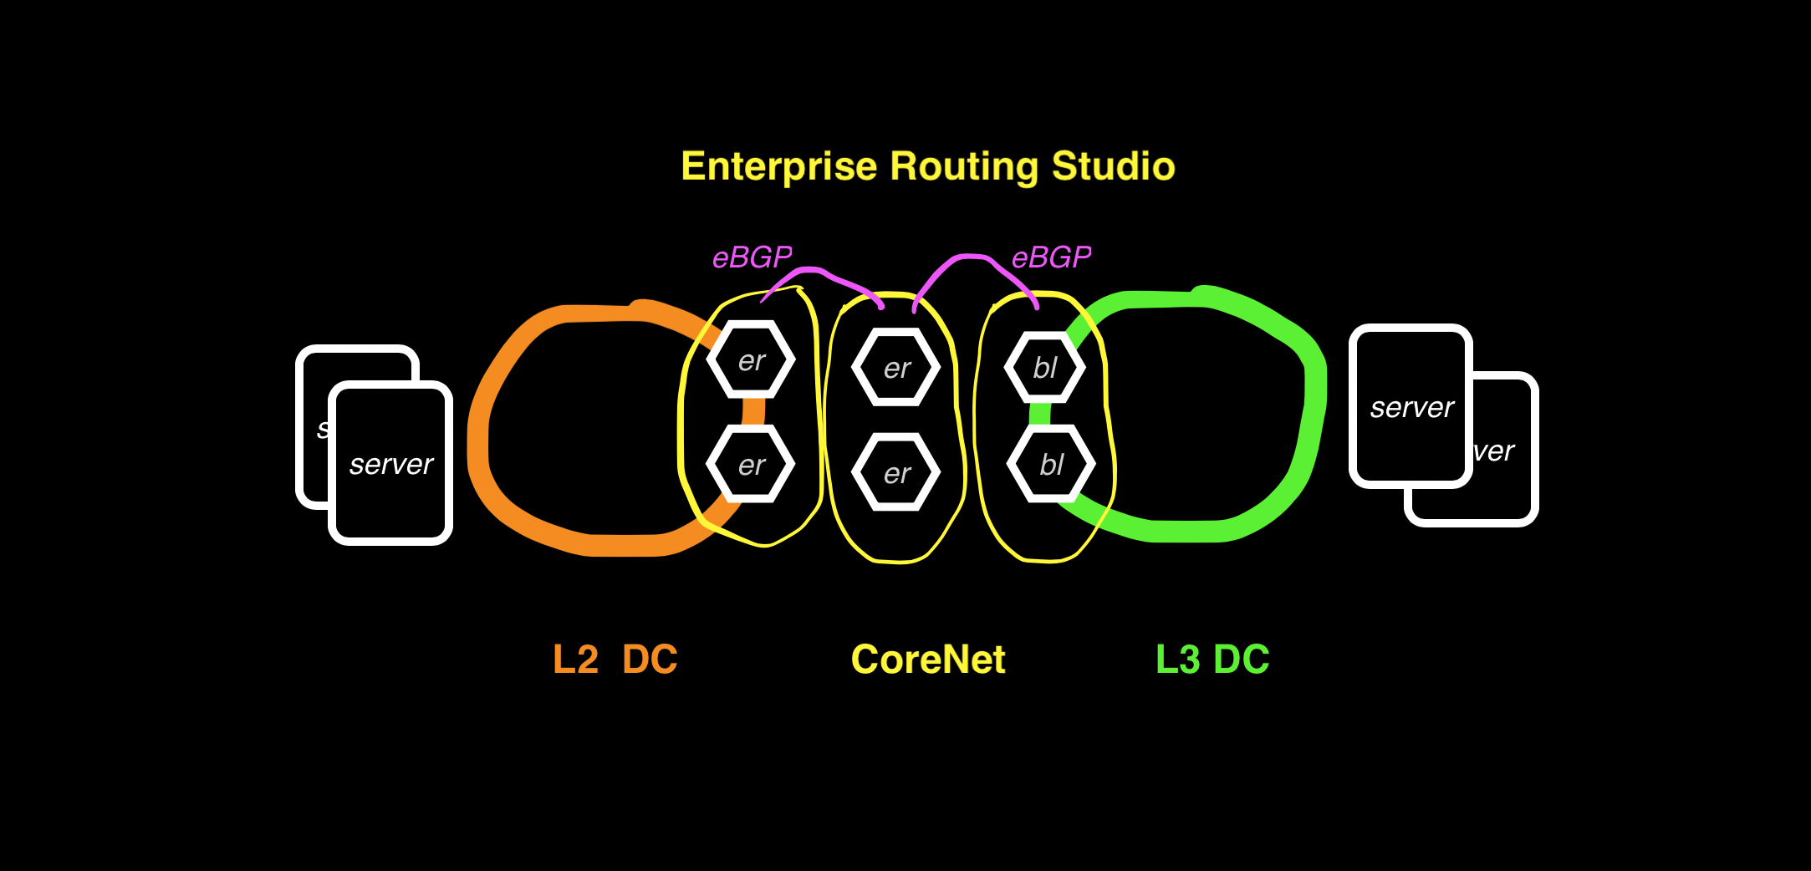
Example8 eBGP Routed Enterprise

Slide 64
Example8 BGP Routed Enterprise No OSPF or EVPN is used in this example
In this example the Enterprise Routing Studio, consisting of 2 Edge Routers in a Camus, 2 Core Routers and 2 Edge Routers in L3DC

Slide 65
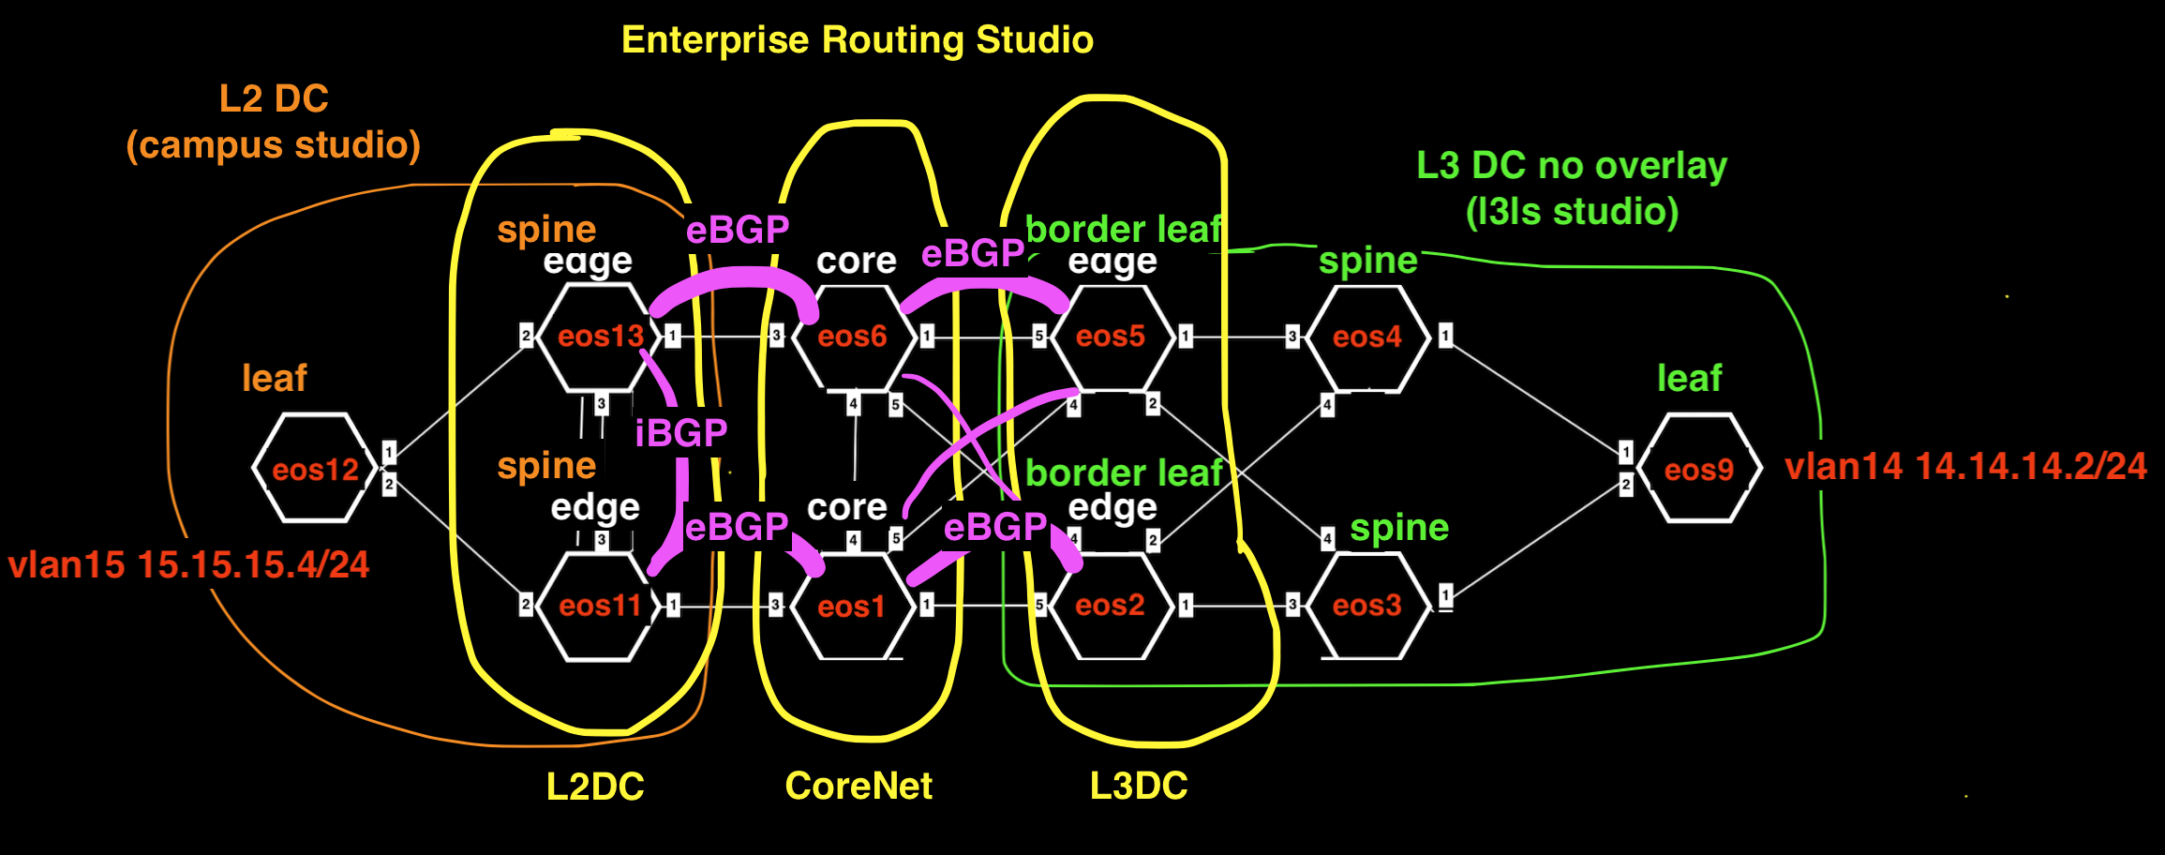
Example8 Detail

Slide 66
Example8 Tags
Campus, L2DC-eos11-eos12-eos13, eos11
Campus, L2DC-eos11-eos12-eos13, eos12
Campus, L2DC-eos11-eos12-eos13, eos13
Campus, L3DC-End-device-eos9, eos9
Campus-Pod, L2DC-eos12, eos12
DC, L3DC-eos2-eos3-eos4-eos5-eos9, eos2
DC, L3DC-eos2-eos3-eos4-eos5-eos9, eos3
DC, L3DC-eos2-eos3-eos4-eos5-eos9, eos4
DC, L3DC-eos2-eos3-eos4-eos5-eos9, eos5
DC, L3DC-eos2-eos3-eos4-eos5-eos9, eos9
DC-Pod, 1, eos2
DC-Pod, 1, eos3
DC-Pod, 1, eos4
DC-Pod, 1, eos5
DC-Pod, 1, eos9
Edge-Router-Domain, 11-13, eos11
Edge-Router-Domain, 11-13, eos13
Edge-Router-Domain, 2, eos2
Edge-Router-Domain, 5, eos5
Edge-Router-Domain, 9, eos9
Leaf-Domain, 2, eos2
Leaf-Domain, 5, eos5
Leaf-Domain, 9, eos9
Leaf-Number, 1, eos2
Leaf-Number, 2, eos5
Leaf-Number, 3, eos9
Network, Ex8-CoreNet-eos1-eos6, eos1
Network, Ex8-CoreNet-eos1-eos6, eos6
Network, L2DC-eos11-eos13, eos11
Network, L2DC-eos11-eos13, eos13
Network, L3DC-Border-Leafs-eos2-eos5, eos2
Network, L3DC-Border-Leafs-eos2-eos5, eos5
Network, L3DC-End-device-eos9, eos9
Role, Core, eos1
Role, Core, eos6
Role, Edge-Router, eos11
Role, Edge-Router, eos13
Role, Edge-Router, eos2
Role, Edge-Router, eos5
Role, Leaf, eos2
Role, Leaf, eos5
Role, Leaf, eos9
Role, Spine, eos3
Role, Spine, eos4
Spine-Number, 1, eos3
Spine-Number, 2, eos4
router_bgp.as, 15, eos11
router_bgp.as, 15, eos13
router_bgp.as, 65000, eos3
router_bgp.as, 65000, eos4
router_bgp.as, 65001, eos2
router_bgp.as, 65001, eos5
router_bgp.as, 65009, eos9
router_bgp.as, 7, eos1
router_bgp.as, 7, eos6
router_bgp.router_id, 1.1.1.1, eos1
router_bgp.router_id, 11.11.11.11, eos11
router_bgp.router_id, 13.13.13.13, eos13
router_bgp.router_id, 172.16.0.1, eos3
router_bgp.router_id, 172.16.0.2, eos4
router_bgp.router_id, 172.16.0.3, eos2
router_bgp.router_id, 172.16.0.4, eos5
router_bgp.router_id, 172.16.0.5, eos9
router_bgp.router_id, 6.6.6.6, eos6

Slide 67
Example8 Device Selection
Enterprise Routing Studio
L3LS Studio
Campus Studio

Slide 68
Example8 Traffic Test
From Campus switch eos12 ping DC Leaf eos9 14.14.14.2
From DC Leaf eos9 14.14.14.2 ping Campus switch eos12

Slide 69
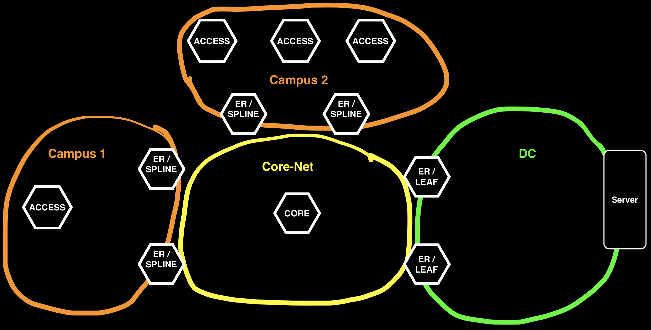
Example9 Campus Switch Stacking

Slide 70
Example9 Campus Switch Stacking Topology 2 Campus networks and a DC
In this example

Slide 71
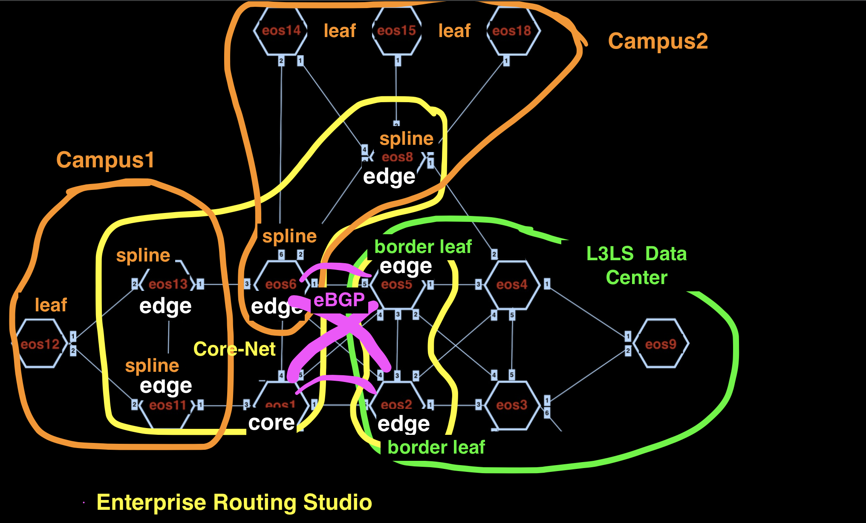
Example9 Detail

Slide 72
Example9 Tags
router_bgp.router_id, 8.8.8.8, eos8
Role, Edge-Router, eos8
Role, Edge-Router, eos11
Role, Edge-Router, eos13
Role, Edge-Router, eos6
router_bgp.router_id, 172.16.0.4, eos5
Stack-Member, 1, eos11
Stack-Member, 1, eos6
router_bgp.router_id, 13.13.13.13, eos13
router_bgp.as, 65001, eos5
router_bgp.as, 65001, eos2
Stack-Member, 2, eos8
Stack-Member, 2, eos13
Leaf-Domain, 2, eos2
Network, Ex9-CoreNet-eos1-eos6-eos8-eos11-eos13, eos8
Network, Ex9-CoreNet-eos1-eos6-eos8-eos11-eos13, eos11
Network, Ex9-CoreNet-eos1-eos6-eos8-eos11-eos13, eos13
Network, Ex9-CoreNet-eos1-eos6-eos8-eos11-eos13, eos6
Network, Ex9-CoreNet-eos1-eos6-eos8-eos11-eos13, eos1
Stack-Member, 3, eos14
Stack-Member, 3, eos12
Edge-Router-Domain, 5, eos5
Stack-Member, 4, eos15
Role, Spine, eos3
Role, Spine, eos4
Stack-Member, 5, eos18
Role, Leaf, eos9
Role, Leaf, eos5
Role, Leaf, eos2
Leaf-Number, 3, eos9
router_bgp.router_id, 1.1.1.1, eos1
Edge-Router-Domain, 2, eos2
Leaf-Number, 1, eos2
DC-Pod, 1, eos9
DC-Pod, 1, eos5
DC-Pod, 1, eos3
DC-Pod, 1, eos2
DC-Pod, 1, eos4
NetworkServices, L3, eos5
NetworkServices, L3, eos2
router_bgp.router_id, 6.6.6.6, eos6
router_bgp.as, 65009, eos9
router_bgp.router_id, 172.16.0.3, eos2
Role, Core, eos1
Vtep, True, eos9
Vtep, True, eos5
Vtep, True, eos2
Edge-Router-Domain, Campus-6-8, eos8
Edge-Router-Domain, Campus-6-8, eos6
router_bgp.as, 7, eos8
router_bgp.as, 7, eos11
router_bgp.as, 7, eos13
router_bgp.as, 7, eos6
router_bgp.as, 7, eos1
Campus, Campus-eos11-eos12-eos13, eos11
Campus, Campus-eos11-eos12-eos13, eos13
Campus, Campus-eos11-eos12-eos13, eos12
Network, Border-Leafs-eos2-eos5, eos5
Network, Border-Leafs-eos2-eos5, eos2
router_bgp.router_id, 172.16.0.5, eos9
router_bgp.router_id, 11.11.11.11, eos11
Campus-Pod, 14-15-18, eos14
Campus-Pod, 14-15-18, eos18
Campus-Pod, 14-15-18, eos15
Leaf-Domain, 9, eos9
Leaf-Number, 2, eos5
DC, DC-eos2-eos3-eos4-eos5-eos9, eos9
DC, DC-eos2-eos3-eos4-eos5-eos9, eos5
DC, DC-eos2-eos3-eos4-eos5-eos9, eos3
DC, DC-eos2-eos3-eos4-eos5-eos9, eos2
DC, DC-eos2-eos3-eos4-eos5-eos9, eos4
router_bgp.as, 65000, eos3
router_bgp.as, 65000, eos4
NetworkServices, L2, eos5
NetworkServices, L2, eos2
Spine-Number, 2, eos4
router_bgp.router_id, 172.16.0.2, eos4
Campus-Pod, 12, eos12
router_bgp.router_id, 172.16.0.1, eos3
Leaf-Domain, 5, eos5
Spine-Number, 1, eos3
Edge-Router-Domain, Campus-11-13, eos11
Edge-Router-Domain, Campus-11-13, eos13
Campus, Campus-eos6-eos8-eos14-eos15-eos18, eos8
Campus, Campus-eos6-eos8-eos14-eos15-eos18, eos14
Campus, Campus-eos6-eos8-eos14-eos15-eos18, eos18
Campus, Campus-eos6-eos8-eos14-eos15-eos18, eos6
Campus, Campus-eos6-eos8-eos14-eos15-eos18, eos15

Slide 73
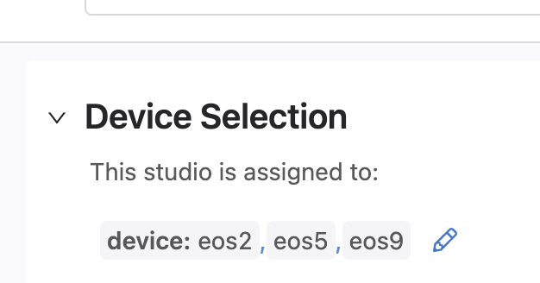
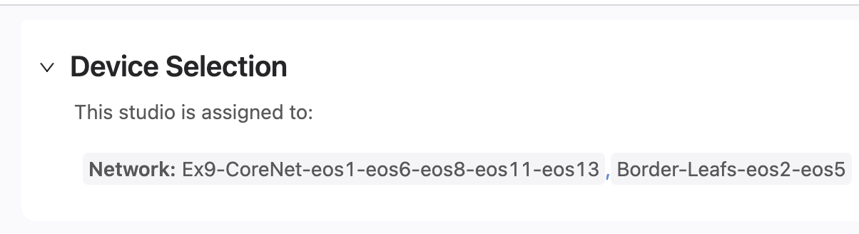



Example9 Device Selection
EVPN Studio
Enterprise Routing Studio
L3LS Studio
Campus Studio
Interface and Stack Studio

Slide 74
Example9 Traffic Test
From Campus1 switch eos12 ping DC Leaf eos9 14.14.14.2
From Campus2 switch eos14 ping DC Leaf eos9 14.14.14.2

Slide 75

Example10 EVPN ETREE

Slide 76
Example10 EVPN ETREE EVPN is used to Stretch L2 to Central FW gateways
blah

Slide 77

Example10 Detail

Slide 78

Example10 Logical Topology

Slide 79
Example10 Tags
Edge-Router-Domain, 18, eos18
Edge-Router-Domain, Internal-FW-Border-Router, eos3
Edge-Router-Domain, Internal-FW-Border-Router, eos1
Edge-Router-Domain, External-FW-eos14, eos14
Role, Edge-Router, eos8
Role, Edge-Router, eos16
Role, Edge-Router, eos7
Role, Edge-Router, eos11
Role, Edge-Router, eos14
Role, Edge-Router, eos18
Role, Edge-Router, eos9
Role, Edge-Router, eos3
Role, Edge-Router, eos13
Role, Edge-Router, eos6
Role, Edge-Router, eos1
Role, Edge-Router, eos15
Role, Edge-Router, eos4
router_bgp.router_id, 4.4.4.4, eos4
router_bgp.as, 18, eos18
router_bgp.router_id, 13.13.13.13, eos13
Edge-Router-Domain, Floor2, eos16
router_bgp.as, 65001, eos7
Edge-Router-Domain, Internal-FW-eos7, eos7
router_bgp.router_id, 18.18.18.18, eos18
Network, Internal-FW-eos7, eos7
Role, RR, eos5
Role, RR, eos2
router_bgp.router_id, 8.8.8.8, eos8
router_bgp.router_id, 5.5.5.5, eos5
router_bgp.router_id, 2.2.2.2, eos2
Network, WAN-Router-eos8, eos8
Edge-Router-Domain, WAN-Router-eos8, eos8
Campus, Site1-Floor2-eos13, eos13
router_bgp.router_id, 10.10.10.10, eos10
router_bgp.router_id, 19.19.19.19, eos19
Campus, Site2-Floor1-eos9, eos9
Network, ISP-eos18, eos18
router_bgp.router_id, 1.1.1.1, eos1
Network, ISP-eos7-eos10-eos19, eos7
Network, ISP-eos7-eos10-eos19, eos19
Network, ISP-eos7-eos10-eos19, eos10
Network, ISP-eos15, eos15
Network, FireWalls-eos8-eos14, eos14
End-Devices, Site1, eos12
Edge-Router-Domain, External-FW-Border-Router, eos6
router_bgp.as, 11214, eos8
router_bgp.as, 11214, eos11
router_bgp.as, 11214, eos14
router_bgp.as, 11214, eos9
router_bgp.as, 11214, eos5
router_bgp.as, 11214, eos3
router_bgp.as, 11214, eos13
router_bgp.as, 11214, eos6
router_bgp.as, 11214, eos1
router_bgp.as, 11214, eos2
router_bgp.as, 11214, eos4
Edge-Router-Domain, 15, eos15
NetworkServices, L3, eos11
NetworkServices, L3, eos9
NetworkServices, L3, eos3
NetworkServices, L3, eos13
NetworkServices, L3, eos6
NetworkServices, L3, eos1
NetworkServices, L3, eos4
router_bgp.router_id, 6.6.6.6, eos6
router_bgp.router_id, 16.16.16.16, eos16
Role, Core, eos19
Role, Core, eos5
Role, Core, eos2
Role, Core, eos10
Network, Site2-End-Device, eos16
Edge-Router-Domain, ISP, eos7
Vtep, True, eos11
Vtep, True, eos9
Vtep, True, eos3
Vtep, True, eos13
Vtep, True, eos6
Vtep, True, eos1
Vtep, True, eos4
Campus, Site1-Floor1-eos11, eos11
router_bgp.router_id, 9.9.9.9, eos9
router_bgp.router_id, 15.15.15.15, eos15
Edge-Router-Domain, Site1, eos11
Edge-Router-Domain, Site1, eos13
router_bgp.router_id, 3.3.3.3, eos3
FW, Internal, eos7
router_bgp.router_id, 11.11.11.11, eos11
router_bgp.router_id, 14.14.14.14, eos14
Network, Firewall-eos7, eos7
FW, External, eos14
NetworkServices, L2, eos11
NetworkServices, L2, eos9
NetworkServices, L2, eos3
NetworkServices, L2, eos13
NetworkServices, L2, eos6
NetworkServices, L2, eos1
NetworkServices, L2, eos4
router_bgp.router_id, 7.7.7.7, eos7
End-Devices, Site2, eos8
End-Devices, Site2, eos16
router_bgp.as, 15, eos15
router_bgp.as, 16, eos16
Network, Ex10-CoreNet-eos1-eos2-eos3-eos4-eos5-eos6-eos9-eos11-eos13, eos11
Network, Ex10-CoreNet-eos1-eos2-eos3-eos4-eos5-eos6-eos9-eos11-eos13, eos9
Network, Ex10-CoreNet-eos1-eos2-eos3-eos4-eos5-eos6-eos9-eos11-eos13, eos5
Network, Ex10-CoreNet-eos1-eos2-eos3-eos4-eos5-eos6-eos9-eos11-eos13, eos3
Network, Ex10-CoreNet-eos1-eos2-eos3-eos4-eos5-eos6-eos9-eos11-eos13, eos13
Network, Ex10-CoreNet-eos1-eos2-eos3-eos4-eos5-eos6-eos9-eos11-eos13, eos6
Network, Ex10-CoreNet-eos1-eos2-eos3-eos4-eos5-eos6-eos9-eos11-eos13, eos1
Network, Ex10-CoreNet-eos1-eos2-eos3-eos4-eos5-eos6-eos9-eos11-eos13, eos2
Network, Ex10-CoreNet-eos1-eos2-eos3-eos4-eos5-eos6-eos9-eos11-eos13, eos4
Network, External-FW-eos14, eos14
Edge-Router-Domain, Site2, eos9
Edge-Router-Domain, Site2, eos4
UNF, ALL, eos8
UNF, ALL, eos7
UNF, ALL, eos11
UNF, ALL, eos14
UNF, ALL, eos18
UNF, ALL, eos9
UNF, ALL, eos5
UNF, ALL, eos3
UNF, ALL, eos13
UNF, ALL, eos6
UNF, ALL, eos1
UNF, ALL, eos2
UNF, ALL, eos15
UNF, ALL, eos4

Slide 80



Example10 Device Selection
EVPN Studio
Enterprise Routing Studio
Interfaces Studio

Slide 81
Example10 Traffic Test
From End Device eos12 ping Internet route 15.15.15.15 and 18.18.18.18 from inside vrfs red-floor1, red-floor2, gray-floor1, gray-floor2, blue-floor1, green-floor1, and green-floor2.
From End Device eos12 test ETREE, from inside vrf red-floor1, eos11 red-floor2 3.1.9.212 and eos16 red-floor2 3.1.9.16 and 3.1.9.8 should not be reachable
From End Device eos12 test ETREE, from inside vrf gray-floor1, eos11 gray-floor2 3.2.0.212 and eos16 gray-floor2 3.2.0.16 and 3.2.0.8 should not be reachable
From End Device eos 12 ping 4.3.1.16 from inside vrf black-floor1
From End Device eos 16 ping Internet route 15.15.15.15 and 18.18.18.18 from inside vrfs red-floor2, gray-floor2.

Slide 82
Example10 Traffic Test
From End Device eos 16 and eos8 ping Internet route 15.15.15.15 and 18.18.18.18 from inside vrfs red-floor2, gray-floor2, and green-floor2.
From End Device eos8 test ETREE, from inside vrf red-floor2, ping GW 3.1.9.14, but eos11 red-floor2 3.1.9.212, eos13 red-floor2 3.1.9.112, and eos16 red-floor2 3.1.9.16 should not be reachable
From End Device eos16 test ETREE, from inside vrf red-floor2, ping GW 3.1.9.14, but eos11 red-floor2 3.1.9.212, eos13 red-floor2 3.1.9.112, and eos8 red-floor2 3.1.9.8 should not be reachable
From End Device eos16 and eos8 from inside vrf green-floor2 ping device eos11 vrf blue 2.3.4.112

Slide 83
Example1 Campus to ISP

Slide 84
Example2 Campus to Campus EVPN

Slide 85
Example3 Campus BGP Underlay

Slide 86
Example4 DC Gateway Router

Slide 87
Example5 BGP DC Interconnect

Slide 88
Example6 OSPF on DC Border Leaf

Slide 89
Example7 DC Border Leaf OSPF per VRF

Slide 90
Example8 eBGP Routed Enterprise

Slide 91

Example9 VRF Lite

Slide 92

Example10 Campus EVPN and L3 to the Edge

Slide 93

Introducing Enterprise Routing Studio
Adds OSPF, ISIS and BGP routing capabilities to Studios

Slide 94

Networks
Networks are groups of devices running OSPF, ISIS, or BGP together
Devices share a common Network tag

Slide 95
New Capabilities
Routing between DCs and Campus fabrics or builds stand-alone networks
Supports multiple networks that can be routed together, or not
Device Roles: Edge Routers, RRs, or Core Router (which can also be a RRs)
Edge Router Domains for pairing 2 routers at a site (MLAGed or not)
Supports routed sub-interfaces
Optional VXLAN and EVPN iBGP control plane can be enabled
EVPN Studio works on top connecting Edge Routers together in the overlay
A Core Router cannot be a vtep or part of an mlag, an Edge Router can

Slide 96
Example1 Campus to ISP

Slide 97
Example1 Detail
core
edge

Slide 98
To import and export Studios Inputs files This is an Alpha feature and needs to be enabled in CV settings. This allows the example files that go with these slides to be uploaded.

Slide 99
Import Studios Data file

Slide 100
Example7 DC Border Leaf OSPF per VRF

Slide 101
Example7 Detail

Slide 102
10 Pre-built Examples on Github
The instructions and files needed for 10 examples of the new Studios capabilities are on Github. Featured is the Enterprise Routing Studio that is used to inter-connect Campus and DCs together to create end-to-end topologies.
Arista Avanced Routing ATDs are used for these examples because they supply an easy environment for getting familiar with the interop between Studios that is required to configure complete networks.
Topologies Covered
Studios Used
Enterprise Routing
EVPN Services
L3LS
Campus
Interface Configuration
DCI
Campus Interconnect
ISP Connections
EVPN for Enterprise

Slide 103
Example Data Files and Tags Files
Found here:
https://github.com/arista-netdevops-community/CloudVisionPortal-Examples/tree/master/CloudVision_Studios/Enterprise%20Routing%20Studio%20Examples
Clone the repository here:
https://github.com/arista-netdevops-community/CloudVisionPortal-Examples

Slide 104

Example 9

